Slide 1
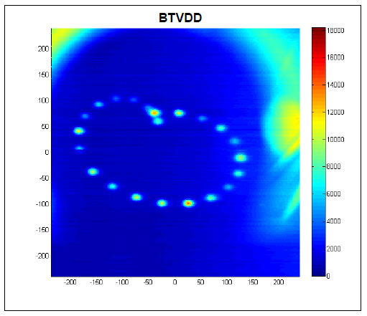


Machine Protection
and Collimation
Rüdiger Schmidt, CERN, CAS Accelerator School, October 2011 - Chios
Beam losses
Continuous beam losses and Collimation
Accidental beam losses and Machine Protection

Slide 2
Proton bunches at the end of their life in LHC: screen in front of the beam dump block

Slide 3
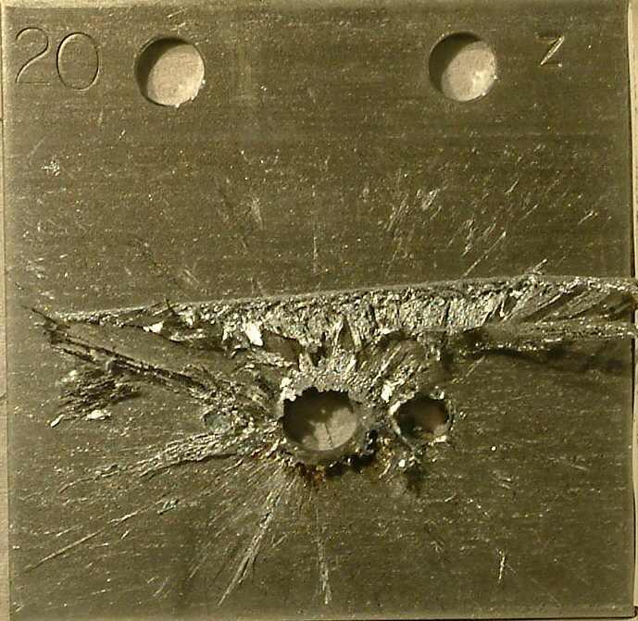
Proton bunches at the end of their life during an SPS test: damage to metal structure

Slide 4
Content
Introduction: Energy and Power
Beam losses
  Continuous beam losses and Collimation
  Accidental beam losses and Machine Protection
Examples for machine protection and collimation for LHC
Beam Cleaning
Machine protection
Outlook
Most examples from LHC, …. apologies to other accelerators…. LHC allows illustration of many principles AND LHC is a hot topic

Slide 5
Protection from Energy and Power
Risks come from Energy stored in a system (Joule), and Power when operating a system (Watt)
  “very powerful accelerator” … the power flow needs to be controlled
An uncontrolled release of the energy or an uncontrolled power flow can lead to unwanted consequences
  Loss of time for operation or damage of equipment
This is true for all systems, in particular for complex systems such as accelerators
  For the RF system, power converters, magnet system …
  For the beams
The 2008 accident during LHC operation happened during test runs without beam

Slide 6
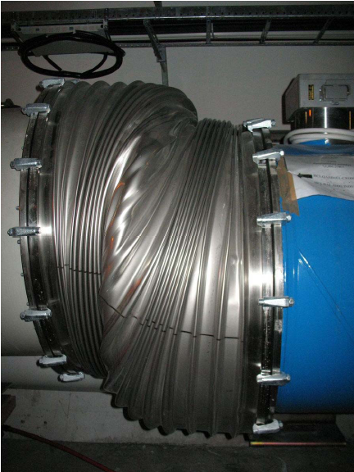

Damage of LHC during the 2008 accident
Accidental release of an energy of 600 MJoule stored in the magnet system - No Beam

Slide 7
Machine Protection for Particle Beams
Many accelerators operate with high beam intensity and/or high energy
For many synchrotrons and storage rings, the energy stored in the beam is increasing with time (from ISR to LHC)
For many linear accelerators and fast cycling machines, the beam power increases
The emittance becomes smaller (down to a beam size of nanometer)
Increasingly important for future projects, with increased beam power / energy density (W/mm² or J/mm² ) and increasingly complex machines (such as ILC and CLIC, but also at XFEL)
!!! Watch out: energy (e.g. 7 TeV) and stored energy (e.g. 362 MJ) !!!

Slide 8
Livingston type plot: Energy stored magnets and beam
Notes:
8

Slide 9
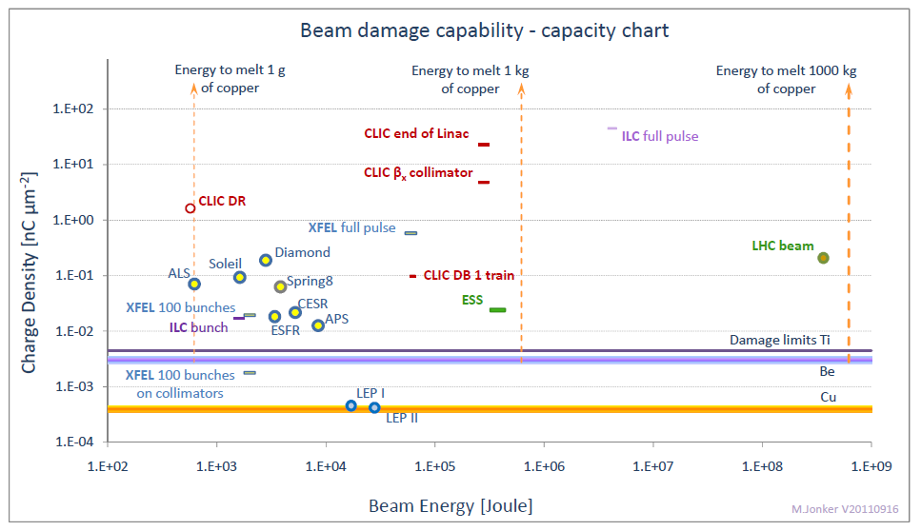
Beam damage capabilities
M.Jonker

Slide 10
Beam losses
10
In accelerators, particles are lost due to a variety of reasons: beam gas interaction, losses from collisions, losses of the beam halo, …
Continuous beam losses are inherent to the operation of accelerators
  Taken into account during the design of the accelerator
Accidental beam losses are due to a multitude of failures mechanisms
The number of possible failures leading to accidental beam losses is (nearly) infinite
Notes:
10

Slide 11

Beam losses, machine protection and collimation
Continuous beam losses: Collimation prevents too high beam losses around the accelerator (beam cleaning)
A collimation system is a (very complex) system installed in an accelerator to capture mostly halo particles
Such system is also called (beam) Cleaning System
Accidental beam losses: “Machine Protection” protects equipment from damage, activation and downtime
Machine protection includes a large variety of systems
11
Notes:
11

Slide 12
Regular and irregular operation
Regular operation
Many accelerator systems
Continuous beam losses
Collimators for beam cleaning
Collimators for halo scraping
Failures during operation
Beam losses due to failures, timescale from nanoseconds to seconds
Machine protection systems
Collimators
Beam absorbers
12
Notes:
12

Slide 13
Beam losses and consequences
Particle losses lead to particle cascades in materials that deposit energy in the material
  the maximum energy deposition can be deep in the material at the maximum of the hadron / electromagnetic shower
The energy deposition leads to a temperature increase
  material can vaporise, melt, deform or lose its mechanical properties
  risk to damage sensitive equipment for some 10 kJ, risk for damage of any structure for some MJoule (depends on beam size)
  superconducting magnets could quench (beam loss of ~mJ to J)
Equipment becomes activated due to beam losses (acceptable is ~1 W/m, but must be “As Low As Reasonably Achievable” - ALARA)

Slide 14
Energy deposition and temperature increase
There is no straightforward expression for the energy deposition
The energy deposition is a function of the particle type, its momentum, and the parameters of the material (atomic number, density, specific heat)
Programs such as FLUKA, MARS, GEANT and others are being used for the calculation of energy deposition and activation
Other programs are used to calculate the response of the material (deformation, melting, …) to beam impact (mechanical codes such as ANSYS, hydrodynamic codes such as BIG2, AUTODYN and others)
Question: what is dangerous (stored beam energy, beam power)? When do we need to worry about protection?

Slide 15
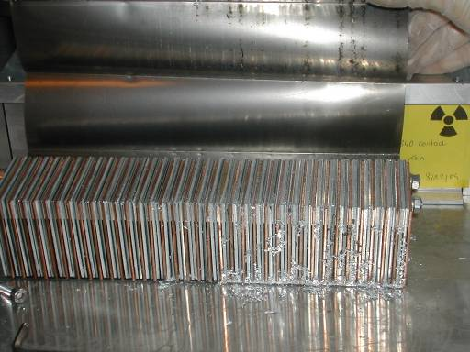
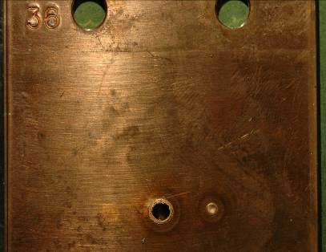
SPS experiment: Beam damage with 450 GeV proton beam
Controlled SPS experiment
8⋅10¹² protons clear damage
beam size σ_{x/y} = 1.1mm/0.6mm
above damage limit for copper
stainless steel no damage
2⋅10¹² protons
below damage limit for copper
25 cm
6 cm
Damage limit ~200 kJoule
0.1 % of the full LHC 7 TeV beams
factor of ~10 below the energy in a bunch train injected into LHC
A B D C
V.Kain et al
15
Notes:
15

Slide 16
Damage of a pencil 7 TeV proton beam (LHC)
copper
Copper
graphite
graphite

Slide 17
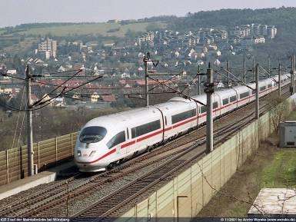
What parameters are relevant?
Momentum of the particle
Particle type
  Activation is mainly an issue for hadron accelerators
Time structure of beam
Energy stored in the beam
  one MJoule can heat and melt 1.5 kg of copper
  one MJoule corresponds to the energy stored in 0.25 kg of TNT
Beam power
  one MWatt during one second corresponds to a MJoule
Beam size
Beam power / energy density (MJoule/mm², MWatt/mm²)
The energy of an 200 m long fast train at 155 km/hour corresponds to the energy of 360 MJoule stored in one LHC beam
Machine protection to be considered for an energy stored in the beam >> 1 kJ
Very important if beam > 1 MJ

Slide 18
Collimation and Machine Protection

Slide 19
Continuous beam losses: Collimation
Limitation of beam losses is in order of 1 W/m to avoid activation and still allow hands-on maintenance
  avoid beam losses – as far as possible
  define the aperture by collimators
  capture continuous particle losses with collimators at specific locations
Continuous beam with a power of 1 MW (SNS, JPARC, ESS)
  a loss of 1% corresponds to 10 kW – not to be lost along the beam line to avoid activation of material, heating, quenching, …
  assume a length of 200 m: 50 W/m, not acceptable
  ideas for accelerators of 5 MW, 10 MW and more….
LHC stored beam with an energy of 360 MJ for 7 TeV operation
  assume lifetime of 10 minutes corresponds to beam loss of 500 kW, not to be lost in superconducting magnets
  reduce losses by four orders of magnitude
….but also: capture fast accidental beam losses

Slide 20
Accidental beam losses: Machine Protection
20
Single-passage beam loss in the accelerator complex (ns - μs)
  transfer lines between accelerators or from an accelerator to a target station (target for secondary particle production, beam dump block)
  failures of kicker magnets (injection, extraction, special kicker magnets, for example for diagnostics)
  failures in linear accelerators
  too small beam size at a target station
Very fast beam loss (ms)
  multi turn beam losses in circular accelerators
  due to a large number of possible failures, mostly in the magnet powering system, with a typical time constant of ~1 ms to many seconds
Fast beam loss (some 10 ms to seconds)
Slow beam loss (many seconds)
Notes:
20

Slide 21
Classification of failures
Type of the failure
  hardware failure (power converter trip, magnet quench, AC distribution failure such as thunderstorm, object in vacuum chamber, vacuum leak, RF trip, kicker magnet misfires, .…)
  controls failure (wrong data, wrong magnet current function, trigger problem, timing system, feedback failure, ..)
  operational failure (chromaticity / tune / orbit wrong values, …)
  beam instability (due to too high beam / bunch current / e-clouds)
Parameters for the failure
  time constant for beam loss
  probability for the failure
  damage potential
Machine state when failure occurs
  beam transfer, injection and extraction (single pass)
  acceleration
  stored beam
defined as risk

Slide 22




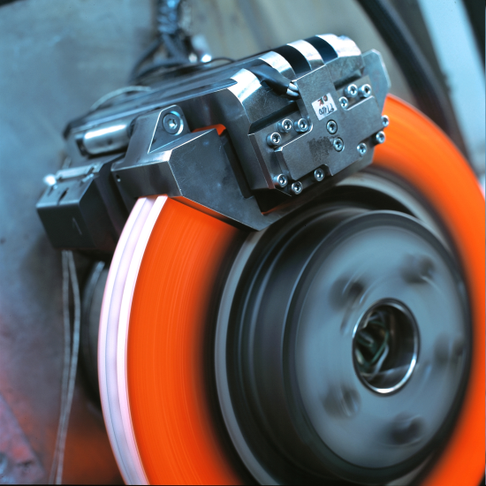
Example for Active Protection - Traffic
A monitor detects a dangerous situation
An action is triggered
The energy stored in the system is safely dissipated

Slide 23

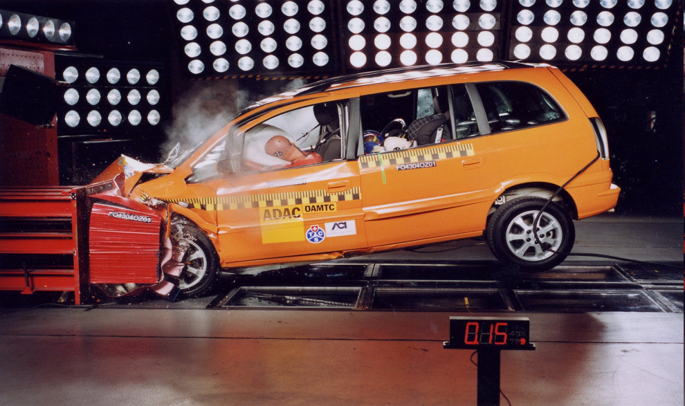
Example for Passive Protection
The monitor fails to detect a dangerous situation
The reaction time is too short
Active protection not possible – passive protection by bumper, air bag, safety belts

Slide 24
Strategy for protection: Protection Systems
Avoid that a specific failure can happen
Detect failure at hardware level and stop beam operation
Detect initial consequences of failure with beam instrumentation ….before it is too late…
Stop beam operation
  stop injection
  extract beam into beam dump block
  stop beam by beam absorber / collimator
Elements in the protection systems
  hardware monitoring and beam monitoring
  beam dump (fast kicker magnet and absorber block)
  collimators and beam absorbers
  beam interlock systems linking different systems

Slide 25
Failures: examples for LHC
Assume that two 100 MJoule beams (= 2*25 kg TNT) are circulating with the speed of light through the 56 mm diameter vacuum chamber and 2 mm wide collimators
Suddenly the AC distribution for CERN fails – no power!
An object falls into the beam
The betatron tune is driven right onto a 1/3 order resonance
Assume we injection beams for the next fill…..
Serious failure during injection – the injection kicker fails

Slide 26
LHC Layout
eight arcs (sectors)
eight long straight section (about 700 m long)
Beam dump blocks
IR5:CMS
Signal to kicker magnet
IR4: RF + Beam instrumentation
IR6: Beam dumping system
IR3: Moment Beam Clearing (warm)
IR7: Betatron Beam Cleaning (warm)
IR2: ALICE
IR8: LHC-B
Detection of beam losses with >3600 monitors around LHC
IR1: ATLAS
Injection
Injection
Beams from SPS

Slide 27
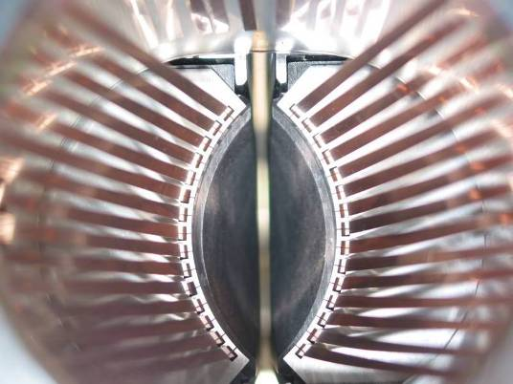
RF contacts for guiding image currents
View of a two sided collimator
for LHC
about 100 collimators are installed
2 mm
Beam spot
length about 120 cm
Ralph Assmann, CERN
Notes:
Die Kollimatorbacken werden ganz nahe and den Strahl gefahren, Der Abstand der Backen kann sehr klein sein, bis zu 2 mm. Die Kupferfinger sind dazu da, um die Impedanz zu minimieren.

Slide 28
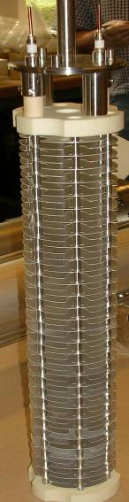
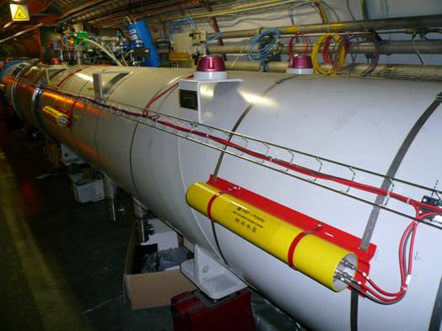
Beam Loss Monitors
Ionization chambers to detect beam losses:
  Reaction time ~ ½ turn (40 μs)
  Very large dynamic range (> 10⁶)
There are ~3600 chambers distributed over the ring to detect abnormal beam losses and if necessary trigger a beam abort !

Slide 29
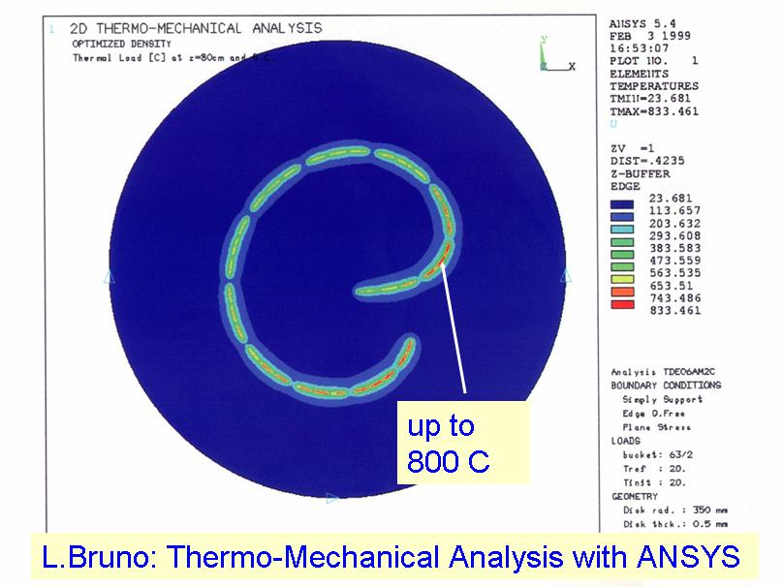
Schematic layout of LHC beam dumping system
Beam 1
Septum magnet deflecting the extracted beam
Q5L
H-V kicker for painting the beam
Beam Dump Block
Q4L
about 700 m
Fast kicker magnet
Q4R
about 500 m
Q5R
Accurate energy tracking between LHC and extraction elements required
Beam 2

Slide 30
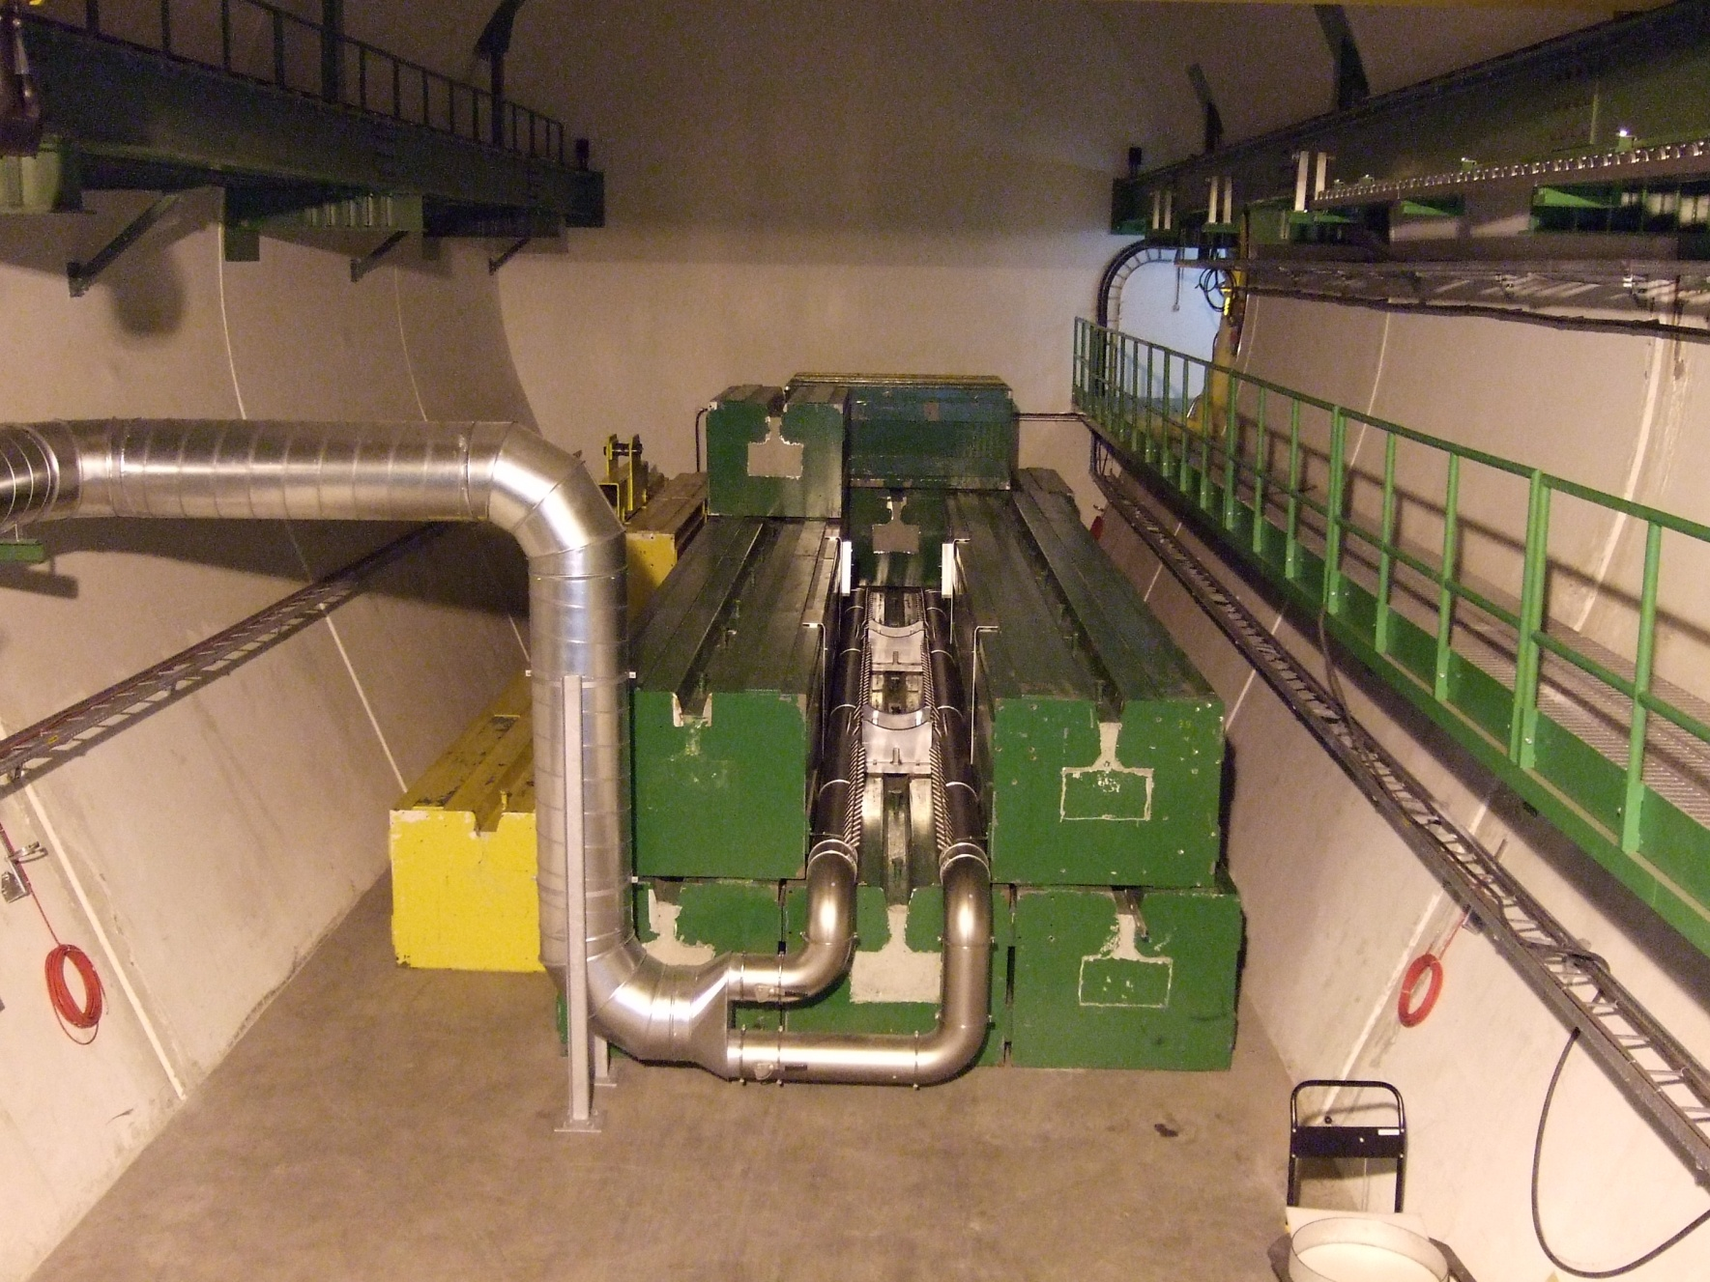
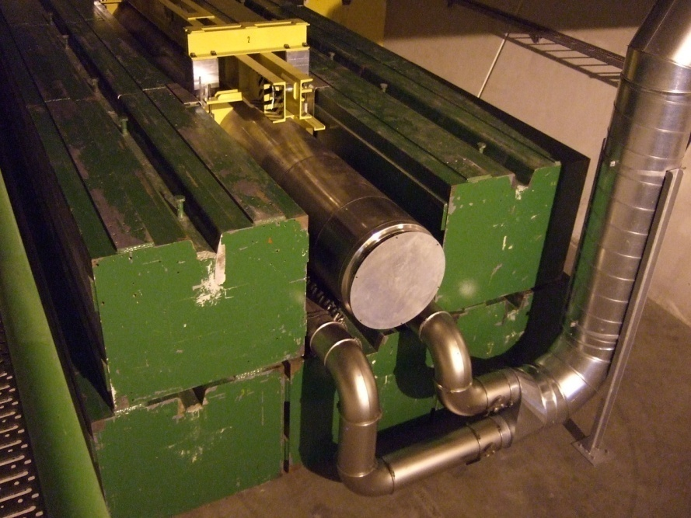
The LHC dump block during the construction phase
CERN visit McEwen
30

Slide 31
Beam dump
Screen in front of the beam dump block
Each light dot shows the passage of one proton bunch traversing the screen
Each proton bunch has a different trajectory, to better distribute the energy across a large volume
50 cm

Slide 32
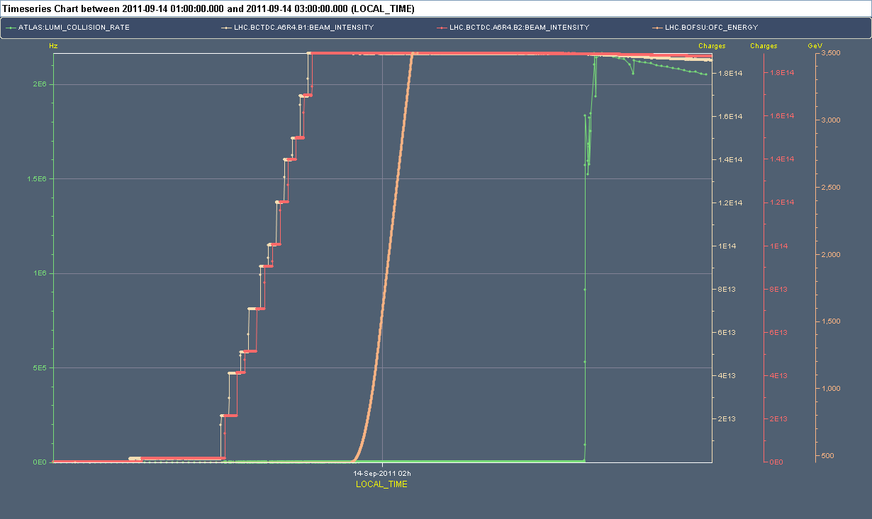
LHC from injection to collisions
3.5 TeV / 100 MJoule
Energy ramp
Luminosity: start collisions
0.45 TeV / 13 MJoule
Injection of 1380 bunches per beam
About 2 hours

Slide 33
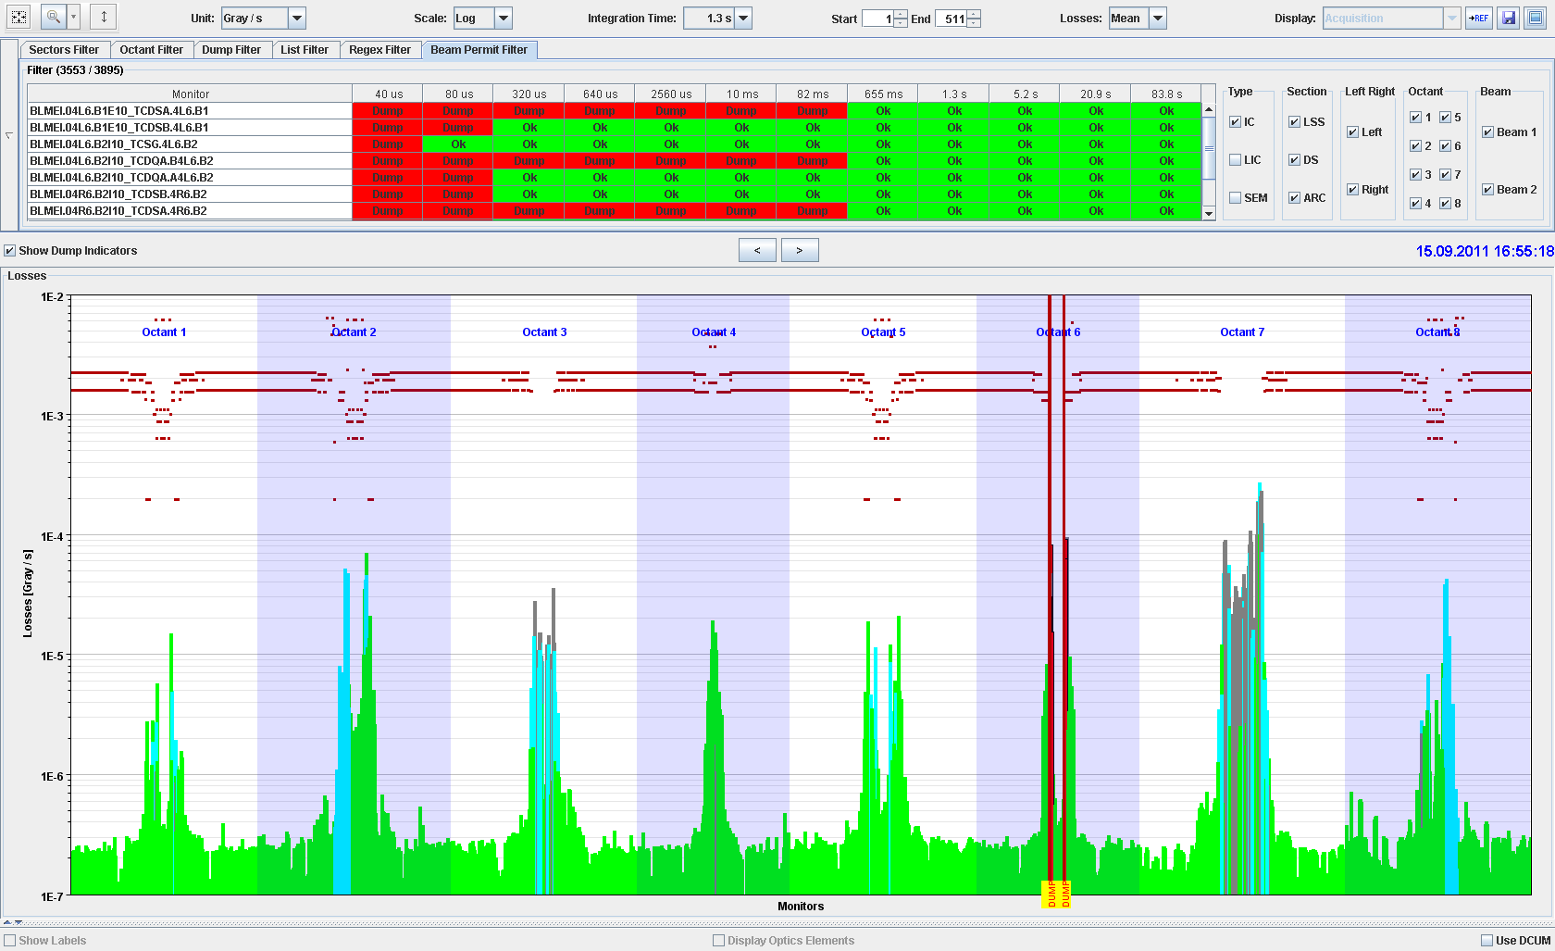
BLM system: beam losses before collisions
ATLAS Experiment
ALICE Experiment
MomentumCleaning
RF and
BI
CMS Experiment
Beam
dump
Betatron Cleaning
LHC Experiment

Slide 34
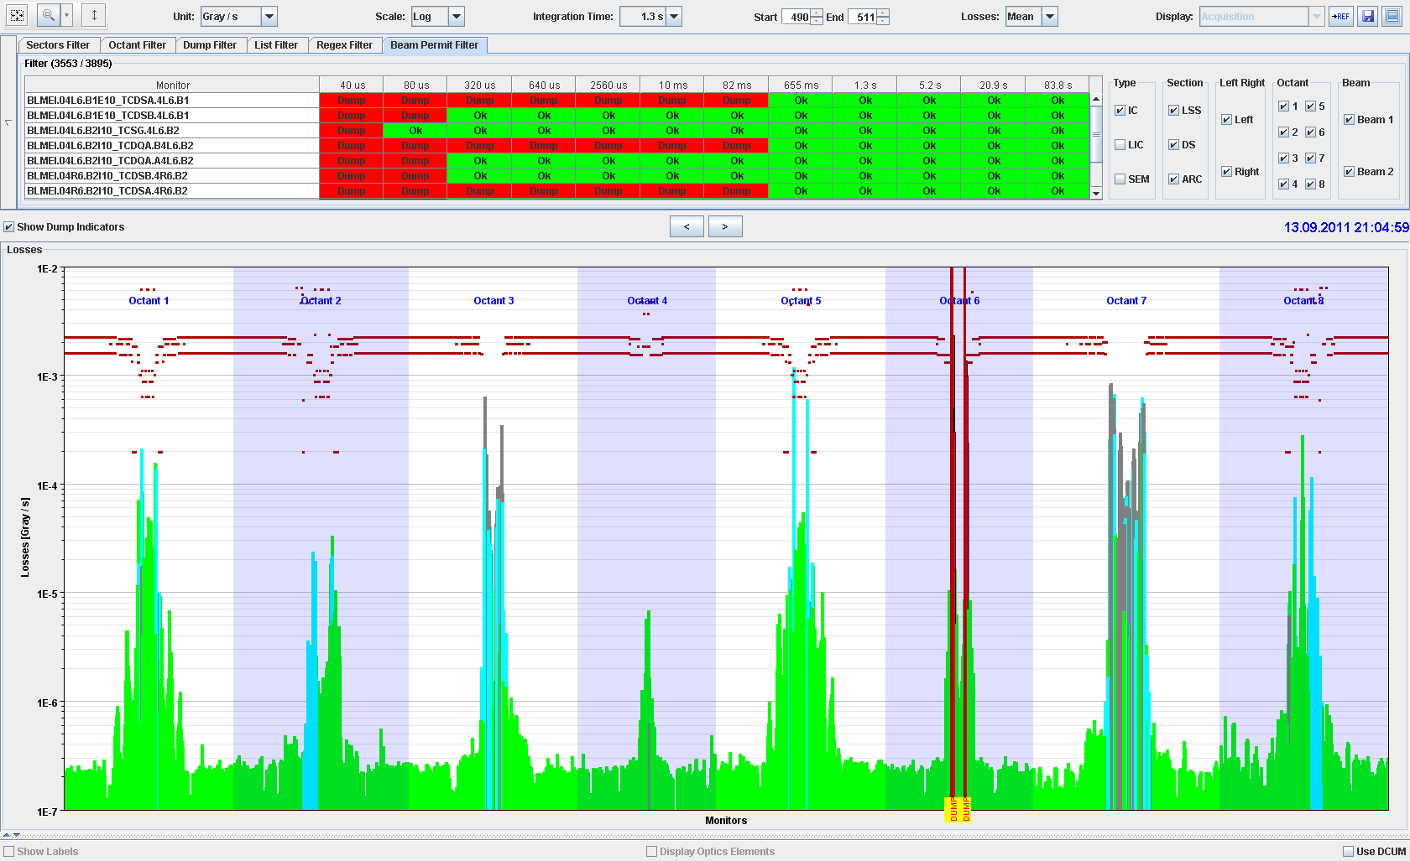
Continuous beam losses during collisions
ATLAS Experiment
ALICE Experiment
MomentumCleaning
RF and
BI
CMS Experiment
Beam
dump
Betatron Cleaning
LHC Experiment
34

Slide 35

Suddenly the AC distribution for CERN fails – no power for LHC!

Slide 36
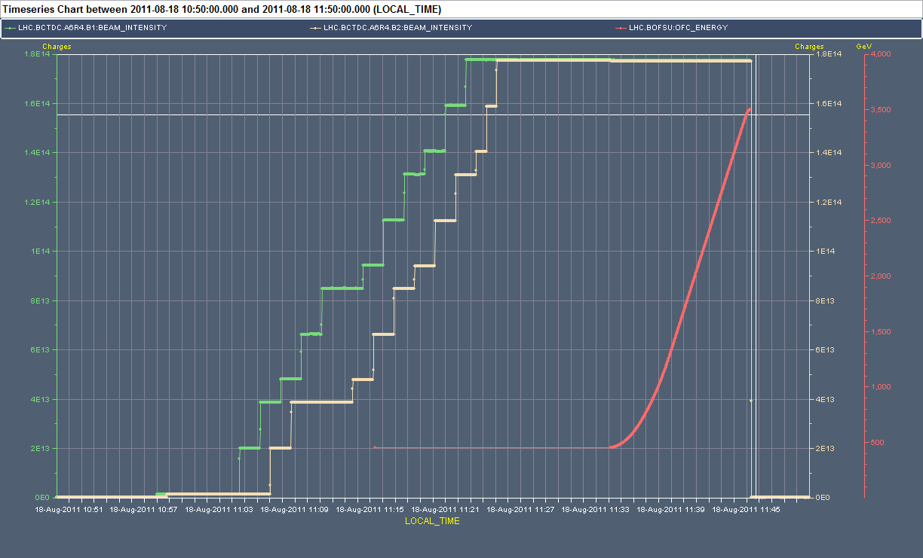
Total power cut at LHC - 18 August 2011, 11:45
Monitors detect a change of magnet current in less than one ms and trigger a beam dump before the beam is affected (FMCM, development with DESY)

Slide 37
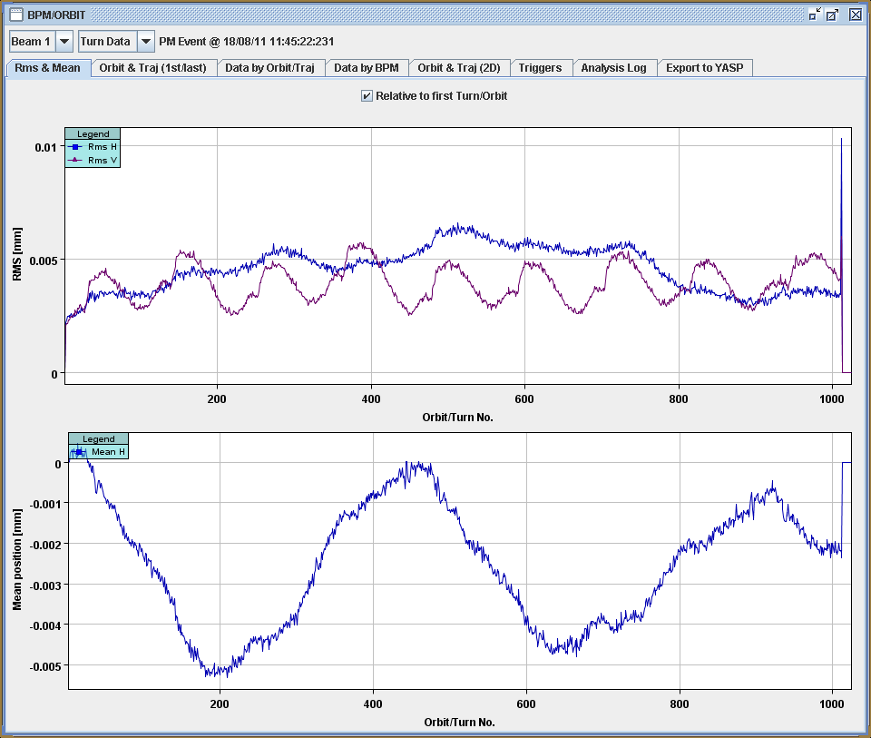
Orbit for last 1000 turns before power cut
10 micrometer

Slide 38

An object falls into the beam

Slide 39
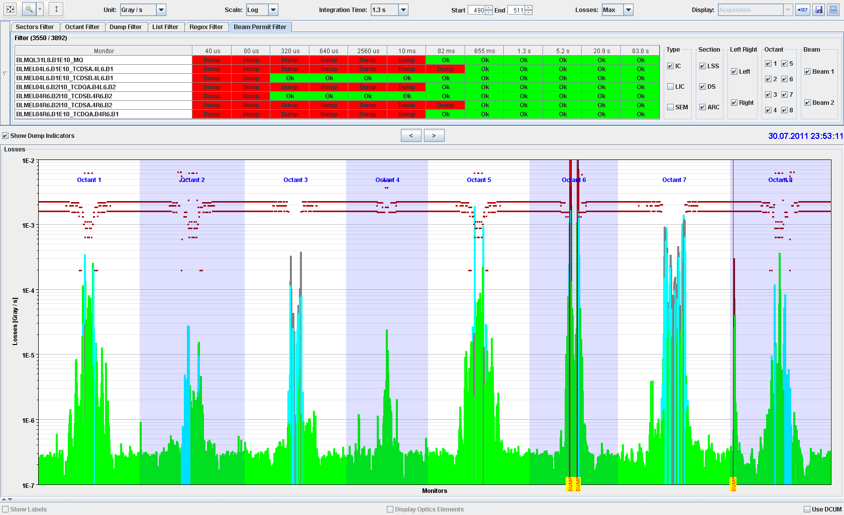
Accidental beam losses during collisions
ATLAS Experiment
ALICE Experiment
MomentumCleaning
RF and
BI
CMS Experiment
Beam
dump
Betatron Cleaning
LHC Experiment
39

Slide 40
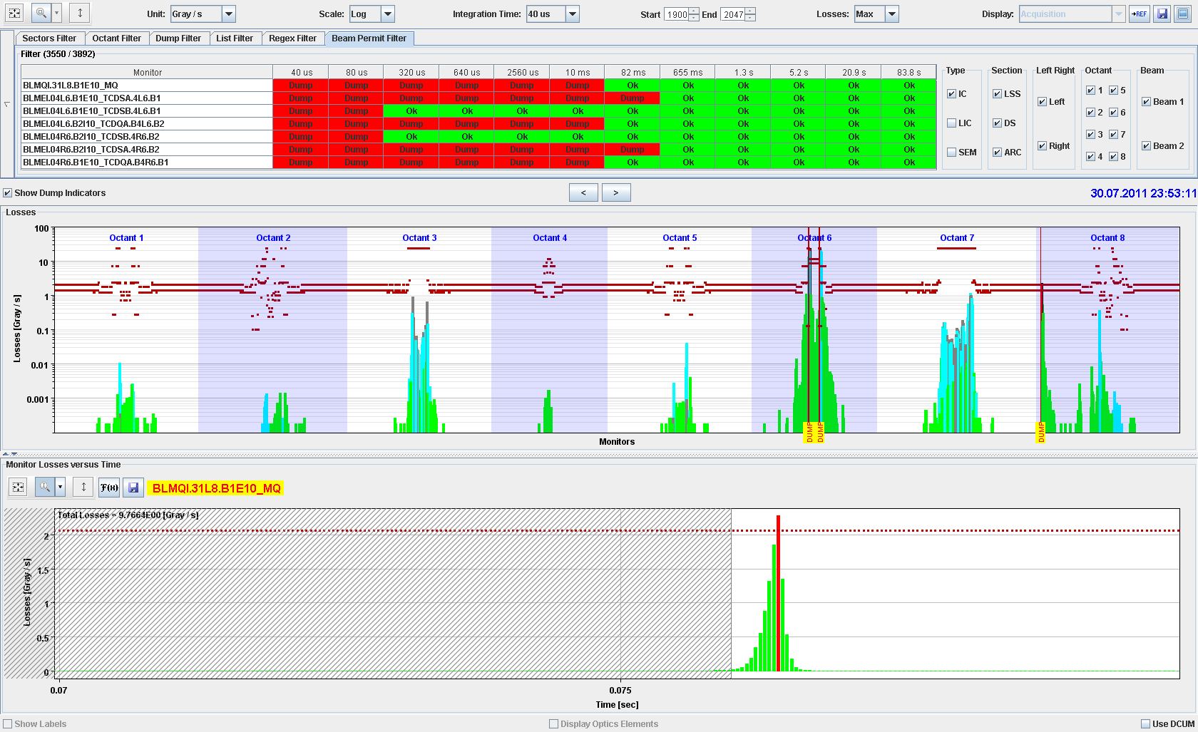
Zoom one monitor: beam loss as a function of time
1 ms

Slide 41
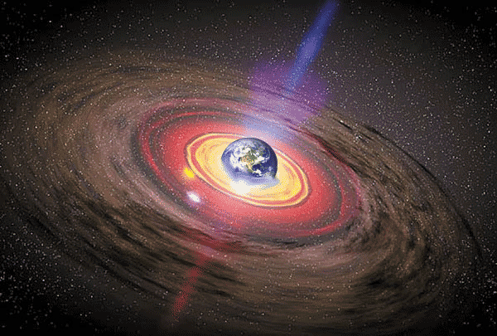

UFOs at LHC
Black holes at LHC ?????

Slide 43
Beam cleaning and machine protection
In case protons are lost because of low lifetime
In case of protons are lost when colliding beams, and scattering of protons during the collisions that would be lost around the LHC
In case of protons outside the RF bucket – losing slowly their energy – are captured by collimators in the Momentum Cleaning Insertion
Too much losses: beam dump
Questions
How to stop high energy protons?
Why so many collimators (…more than 100)?
Why carbon composites or graphite used for most collimators?

Slide 44
SPS, transfer line and LHC
Beam is accelerated in SPS to 450 GeV (stored energy of 3 MJ)
Beam is transferred from SPS to LHC
Beam is accelerated in LHC to 3.5 TeV (stored energy of 100 MJ)
Scraping of beam in SPS before transfer to LHC
IR8
Injection kicker
Switching magnet
CNGS Target
Fast extraction kicker
SPS
6911 m
450 GeV / 400 GeV
3 MJ
Acceleration cycle of ~10 s
Transfer line 3km
Injection kicker
LHC
IR2
Fast extraction kicker
1 km
Transfer line

Slide 45

Protection at injection
LHC vacuum chamber
LHC circulating beam
Transfer line vacuum chamber
Circulating beam in LHC

Slide 46
Protection at injection
LHC circulating beam
LHC injected beam
Beam from SPS
Injection Kicker
Beam injected from SPS and transfer line

Slide 47
Protection at injection
LHC circulating beam
Beam from SPS
Injection Kicker
Kicker failure (no kick)

Slide 48
Protection at injection
phase advance 90⁰
LHC circulating beam
Beam from SPS
Injection Kicker
Injection absorber
(TDI) ~7σ
Set of transfer line collimators (TCDI) ~5σ
Beam absorbers take beam in case of kicker misfiring
Transfer line collimators ensure that incoming beam trajectory is ok

Slide 49
Protection at injection
phase advance 90⁰
LHC circulating beam
LHC circulating beam
Circulating beam – kicked out
Injection Kicker
Injection absorber
(TDI) ~7σ
Set of transfer line collimators (TCDI) ~5σ
Beam absorbers take beam in case of kicker misfiring on circulating beam

Slide 50
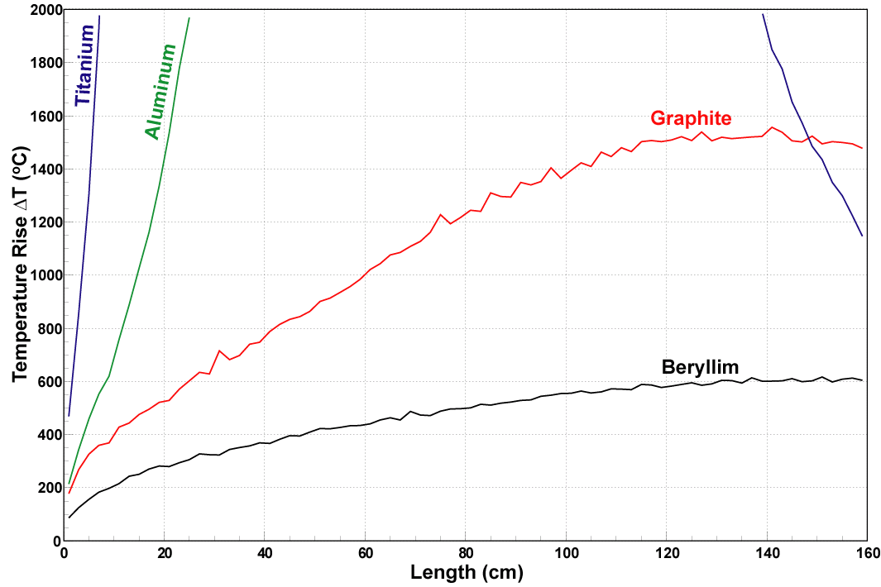
Collimator material
For collimators close to the beam, metal absorbers would be destroyed
Other materials for collimators close to the beam are preferred (carbon – carbon)
P.Sievers / A.Ferrari /
V. Vlachoudis
7 TeV, 2⋅10¹² protons
50
Metal absorbers would be destroyed
Other materials for injection absorber preferred, graphite or boron nitride for the injection absorber
In case of a partial kick (can happen), the beam travels further to the next collimators in the cleaning insertions
Notes:
50

Slide 51
Phase space and collimation
x’
x’
x
Starting with a Gaussian beam profile
51
Notes:
51

Slide 52
Phase space and collimation
x’
x’
x
Collimator outside the beam
52
Notes:
52

Slide 53
Phase space and collimation: multi turn
x’
x’
x
Collimator driven into the beam tail: loss of particles
53
Notes:
53

Slide 54
Phase space and collimation: multi turn
x’
x’
x
Collimator again outside the beam – beam size reduction (for proton synchrotrons)
54
Notes:
54

Slide 55
Phase space and collimation: single turn
x’
x’
x
Collimator in a transfer line or linac: cuts only part of the beam
55
Notes:
55

Slide 56
Phase space and collimation: single turn
x’
x’
x
Collimator in a transfer line or linac: cuts only part of the beam
56
Notes:
56

Slide 57
Phase space and collimation: single turn
x’
x’
x
Collimator in a transfer line or linac: several collimators are required
57
Notes:
57

Slide 58
Phase space and collimation: single turn
x’
x’
90 degrees further down
x
Collimator in a transfer line or linac: several collimators are required …. at different betatron phases
58
Notes:
58

Slide 59
Gaussian beam not collimated

Slide 60
Gaussian beam collimated at 4 sigma
N = 0.999 (number of protons)
L = 0.999 (luminosity)

Slide 61
Gaussian beam collimated at 3 sigma
N= 0.987
L = 0.992

Slide 62
Gaussian beam collimated at 2 sigma
N= 0.863
L = 0.866

Slide 63
Collimation: why so many?
Answer A:
For a transfer line or a linear accelerator, many collimators are required to remove particles at all phases
Answer B:
Cite: “It is not possible to stop a high energy proton, it is only possible to make them mad”
Collimators cannot stop a high energy proton
The particle impact on a collimator jaw is very small, in the order of microns or even less
63
Notes:
63

Slide 64
Collimation: why so many?
jaw
betatron oscillation
orbit
Impact parameter
jaw
64
Notes:
64

Slide 65
Collimation: why so many?
Answer A:
For a transfer line or a linear accelerator, many collimators are required to remove particles at all phases
Answer B:
Cite: “It is not possible to stop a high energy proton, it is only possible to make them mad”
Collimators cannot stop a high energy proton
The particle impact on a collimator jaw is very small, in the order of microns or even less
Particles scatter….. depends on particle type, energy and impact on collimator jaw
Staged collimation system in a ring and in a transfer line
65
Notes:
65

Slide 66
Betatron beam cleaning
Primary
collimator
Secondary
collimators
Shower
absorbers
Tertiary
collimators
SC
Triplet
Cold aperture
Tertiary beam halo
+ hadronic showers
Circulating beam
Arc(s)
Cleaning insertion
Arc(s)
IP
Illustration drawing

Slide 67
Measurement: 500kJ losses at primary collimators (loss rate: 9.1e11 p/s) – IR7
Q8L7:
~ 6.7e-4
Lower limit:
R_{q}L_{dil} ~ 1.22e9 p/s (with c_{resp}= 2 )
TCP: ~505 kJ
Lost energy over 1 s
Q8L7: ~335 J
Q11L7: ~35 J
Q19L7: ~4.7 J

Slide 68
Collimation: why Carbon?
Simulation
8 nominal LHC bunches (out of 2808) at 7 TeV hit a tungsten collimation
Courtesy of A.Bertarelli et al.
68
Notes:
68

Slide 69
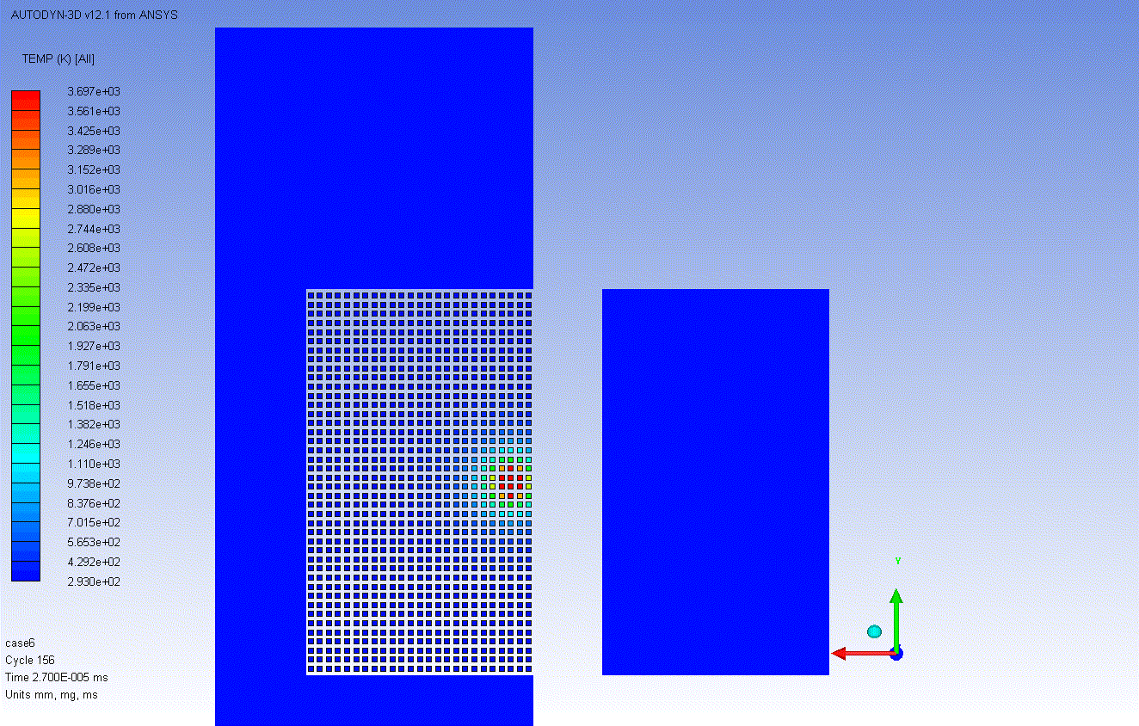

Film from Alessandro

Slide 70
Strategy for machine protection
Definition of aperture by collimators.
Beam Cleaning System
Early detection of failures for equipment acting on beams generates dump request, possibly before the beam is affected.
Powering Interlocks
Fast Magnet Current change Monitor
Active monitoring of the beams detects abnormal beam conditions and generates beam dump requests down to a single machine turn.
Beam Loss Monitors
Other Beam Monitors
Reliable operation of beam dumping system for dump requests or internal faults, safely extract the beams onto the external dump blocks.
Beam Dumping System
Reliable transmission of beam dump requests to beam dumping system. Active signal required for operation, absence of signal is considered as beam dump request and injection inhibit.
Beam Interlock System
Passive protection by beam absorbers and collimators for specific failure cases.
Collimator and Beam Absorbers

Slide 71
Accidental beam losses: Risks and protection
Protection is required since there is some risk
Risk = probability of an accident (in number of accidents per year) • consequences (in Euro, downtime, radiation dose to people)
Probability of an accidental beam loss
  What are the failure modes the lead to beam loss into equipment (there is an practical infinite number of mechanisms to lose the beam)?
  What is the probability for the most likely failures?
Consequences of an accidental beam loss
  Damage to equipment
  Downtime of the accelerator for repair (spare parts available?)
  Activation of material, might lead to downtime since access to equipment is delayed
The higher the risk, the more protection becomes important

Slide 72
Some design principles for protection systems
Failsafe design
  detect internal faults
  possibility for remote testing, for example between two runs
  if the protection system does not work, better stop operation rather than damage equipment
Critical equipment should be redundant (possibly diverse)
Critical processes not by software (no operating system)
  no remote changes of most critical parameters
Demonstrate safety / availability / reliability
  use established methods to analyse critical systems and to predict failure rate
Managing interlocks
  disabling of interlocks is common practice (keep track !)
  LHC: masking of some interlocks possible for low intensity / low energy beams

Slide 73
Accelerators that require protection systems I
Hadron synchrotrons with large stored energy in the beam
  Colliders using protons / antiprotons (TEVATRON, HERA, LHC)
  Synchrotrons accelerating beams for fixed target experiments (SPS)
High power accelerators (e.g. spallation sources) with beam power of some 10 kW to above 1 MW
  Risk of damage and activation
  Spallation sources, up to (and above) 1 MW quasi-continuous beam power (SNS, ISIS, PSI cyclotron, JPARC, and in the future ESS, MYRRHA and IFMIF)
Synchrotron light sources with high intensity beams and secondary photon beams
Energy recovery linacs
  Example of a prototype at Daresbury: one bunch train cannot damage equipment, but in case of beam loss the next bunch train must not leave the (injector) station
73
Notes:
73

Slide 74
Accelerators that require protection systems II
Linear colliders / accelerators with very high beam power densities due to small beam size
  High average power in linear accelerators: FLASH 90 kW, European XFEL 600 kW, SNS 1.4 MW, JLab FEL 1.5 MW, ILC 11 MW
  One beam pulse can lead already to damage
  “any time interval large enough to allow a substantial change in the beam trajectory of component alignment (~fraction of a second), pilot beam must be used to prove the integrity” from NLC paper 1999
Medical accelerators: prevent too high dose to patient
  Low intensity, but techniques for protection are similar
Very short high current bunches: beam induces image currents that can damage the environment (bellows, beam instruments, cavities, …)
74
Notes:
74

Slide 75
Beam instrumentation for machine protection
Beam Loss Monitors
  stop beam operation in case of too high beam losses
  monitor beam losses around the accelerator (full coverage?)
  could be fast and/or slow (LHC down to 40 μs)
Beam Position Monitors
  ensuring that the beam has the correct position
  in general, the beam should be centred in the aperture
  for extraction: monitor extraction bump using BPMs (redundant to magnet current)
Beam Current Transformers
  if the transmission between two locations of the accelerator is too low (=beam lost somewhere): stop beam operation
  if the beam lifetime is too short: dump beam
Beam Size Monitors
  if beam size is too small could be dangerous for windows, targets, …

Slide 76
For future high intensity machines
Machine protection should always start during the design phase of an accelerators
Particle tracking
  to establish loss distribution with realistic failure modes
  accurate aperture model required
Calculations of the particle shower (FLUKA, GEANT, …)
  energy deposition in materials
  activation of materials
  accurate 3-d description of accelerator components (and possibly tunnel) required
Coupling between particle tracking and shower calculations
From the design, provide 3-d model of all components

Slide 77
Summary
Machine protection
is not equal to equipment protection
requires the understanding of many different type of failures that could lead to beam loss
requires comprehensive understanding of all aspects of the accelerator (accelerator physics, operation, equipment, instrumentation, functional safety)
touches many aspects of accelerator construction and operation
includes many systems
is becoming increasingly important for future projects, with increased beam power / energy density (W/mm² or J/mm² ) and increasingly complex machines
....is a fascinating subject…at least as long as nothing breaks

Slide 78
References
R.B.Appleby et. al., Beam-related machine protection for the CERN Large Hadron Collider experiments, Phys. Rev. ST Accel. Beams 13, 061002 (2010)
R.Schmidt et al., Protection of the CERN Large Hadron Collider, New Journal of Physics 8 (2006) 290
Machine Protection, R.Schmidt, CERN CAS 2008 Dourdan on Beam Diagnostics
N.Tahir et al., Simulations of the Full Impact of the LHC Beam on Solid Copper and Graphite Targets, IPAC 2010, Kyoto, Japan, 23 - 28 May 2010
LHC Machine Protection System: Method for Balancing Machine Safety and Beam Availability / Wagner, Sigrid, CERN-THESIS-2010-215
Redundancy of the LHC machine protection systems in case of magnet failures / Gomez Alonso, CERN-THESIS-2009-023
A Beam Interlock System for CERN High Energy Accelerators / Todd, Benjamin, CERN-THESIS-2007-019
Machine Protection and Beam Quality during the LHC Injection Process / Verena Kain, V K, CERN-THESIS-2005-047
Reliability of the Beam Loss Monitors System for the Large Hadron Collider at CERN / Guaglio, G, CERN-THESIS-2006-012 PCCF-T-0509
Lars Fröhlich, Dissertation, Department Physik der Universität Hamburg, 2009, "Machine Protection for FLASH and the European XFEL"
Conference reports in JACOW, keywords: machine protection, beam loss

Slide 79


