Slide 1
Chapter 10
Acceleration and longitudinal phase space
Rüdiger Schmidt (CERN) – Darmstadt TU - 2011, version E2.4

Slide 2
Beam optics essentials....
Description for particle dynamics with transfer matrices
Differential equation for particle dynamics
Description of particle movement with the betatron function
Betatron oscillation
Beam size:
Working points: Q values
Closed Orbit
Dispersion

Slide 3
Overview
Acceleration with RF fields
Bunches
Phase focusing in a Linear Accelerator
Phase focusing in a Circular Accelerator
Equation of motion for the longitudinal plane
Synchrotron frequency

Slide 4
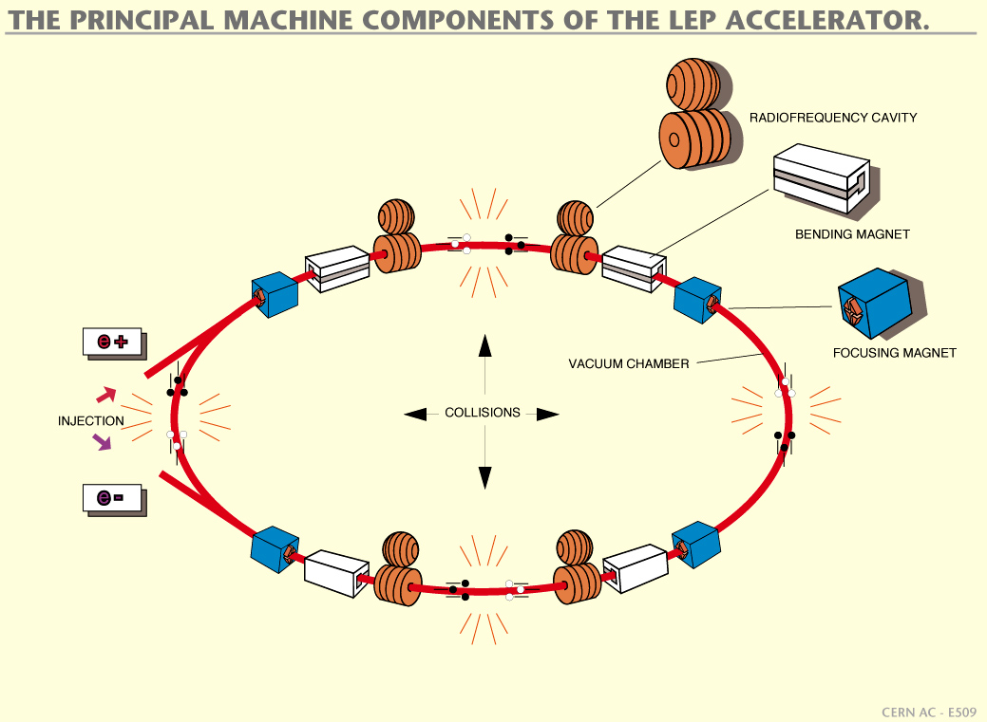
Principal machine components of an accelerator
Kreisbeschleuniger: Beschleunigung durch vielfaches Durchlaufen durch (wenige) Beschleunigungstrecken
⇒

Slide 5
Acceleration in a Cavity for T=0 (accelerating phase)
(100 MHz)
2a
z
E(z)
g
E₀
z

Slide 6
Acceleration in a Cavity for T=5ns (de-cellerating phase)
(100 MHz)
2a
z
E(z)
g
z
-E₀

Slide 7
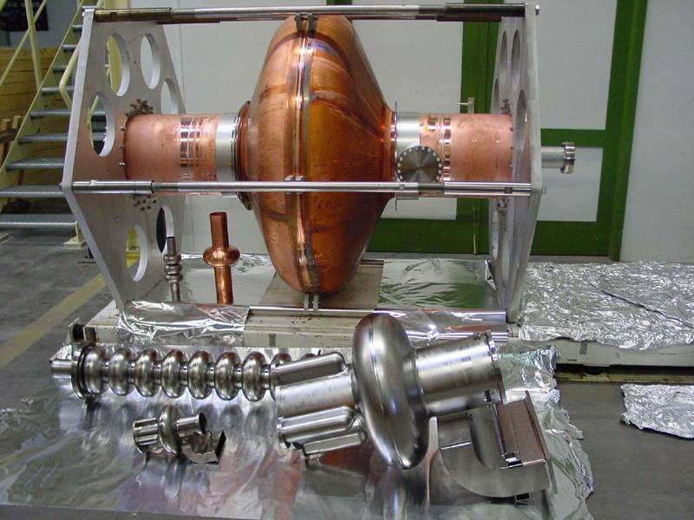
Super conducting cavities (Cornell)
Cavity 200 MHz
Cavity 1300 MHz
Cavity 500 MHz

Slide 8
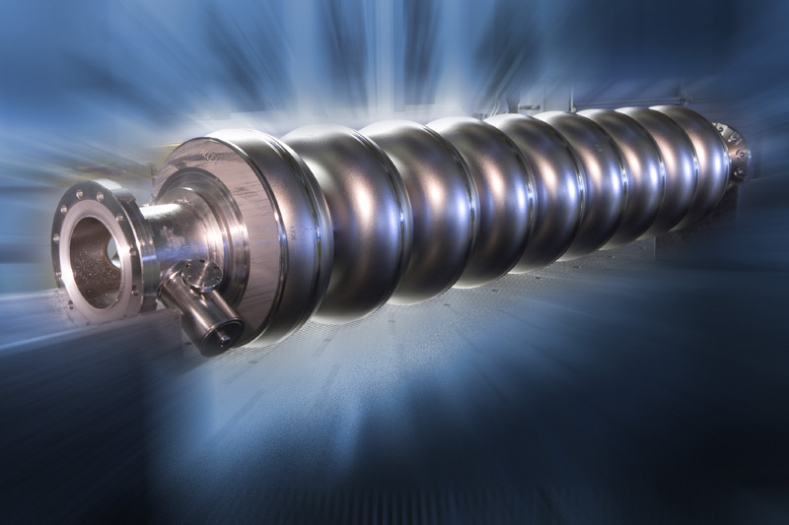
Super conducting cavity with 9 cells (XFEL, DESY)

Slide 9
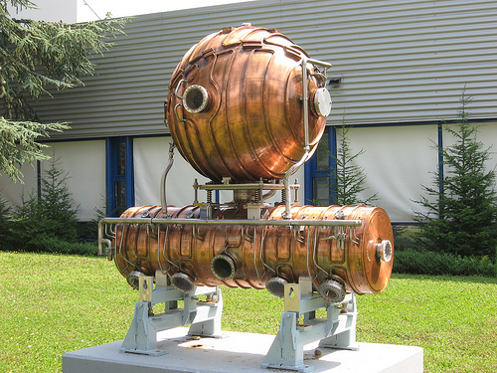
Normal conducting cavity for LEP

Slide 10
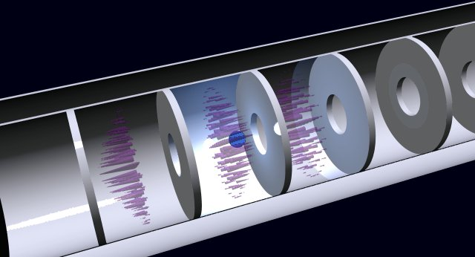
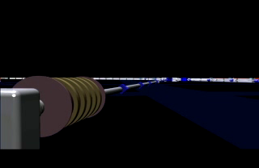
Illustration for the electrical field in a cavity

Slide 11
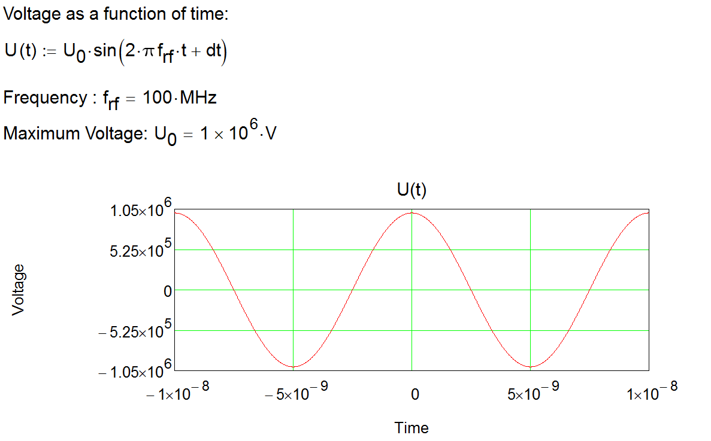
Acceleration in time dependent field
Cavity

Slide 12
Acceleration with Cavities
z
Cavity 1
Cavity 2
A particle enters the cavity from the left. For acceleration, it needs to have the correct phase in the electric field.
Assume that particle 1 travels at time t₀ = 0 ns through cavity 1 – it will be accelerated by 1 MV. A particle that travels through the cavity at another time will be accelerated less, or decelerated.
„decelleration"
t₀ = 0

Slide 13
Bunches
It is not possible to accelerate continuous beam in an RF field – acceleration is always in bunches
The bunch length depends on several parameters, such as frequency and voltage, and ranges from mm to m (in modern linacs possibly less than mm, and micro bunching can happen)
Phase focusing is an essential mechanism to keep the particles in a bunch

Slide 14
Phase focusing in a Linac– increasing field
Cavity 1
z

Slide 15
Phase focusing in a Linac
z
Cavity 1
Cavity 2
We assume three particles, the velocity is much less than the speed of light.
  A particle with nominal momentum
  A particle with more energy, and therefore higher velocity (blue)
  A particle with less energy, and therefore smaller velocity (green)
The red particle enters the cavity at t = 1.25 ns. It is assumed that the electrical field increases (rising part of the RF field)
The green particle enters the cavity later at t = 1.55 ns and experiences a higher field
The blue particle enters the cavity earlier at t = 0.95 ns, and experiences a lower field

Slide 16
Phase focusing in a Linac
Assume that the difference in energy is large enough and the velocity is below the speed of light.
Before entering cavity 1:
v_{blue} > v_{red} > v_{green}
After exiting entering cavity 1:
v_{green} > v_{red} > v_{blue}
The velocity of the green particle is largest and it will take over the other two particles after a certain distance .

Slide 17
Phase focusing in a Linac– Synchrotron oscillations
z
Cavity 1
Cavity 2

Slide 18
Phase de-focusing – decreasing field
Cavity 1
z
The particle with less energy and less velocity (green) arrives late at t = 1.55 ns. It is accelerated less than the other particles. The velocity difference between the particles increases, and the particles are de-bunching.

Slide 19
Phase de-focussing in a Linac
z
Cavity 1
Cavity 2

Slide 20
Phase focusing in a circular accelerator
Cavity
p₀ + dp
The particles with different momenta are circulating on different orbits, here shown simplified as a circle.
p₀
p₀ - dp

Slide 21
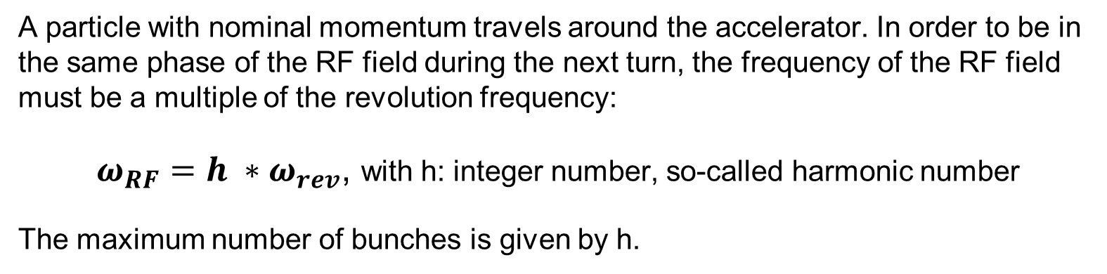
RF-frequency and revolution frequency
A particle with nominal momentum travels around the accelerator. In order to be in the same phase of the RF field during the next turn, the frequency of the RF field must be a multiple of the revolution frequency:
$ω_{RF}=h ∗ω_{rev}$, with h: integer number, so-called harmonic number
The maximum number of bunches is given by h.
Here: h = 8

Slide 22
Momentum Compaction Factor
From beam optics
A particle with different momentum travels on a different orbit with respect to the orbit of a particle with nominal momentum.
The momentum compaction factor is the relative difference of the orbit length:
It can be shown that the momentum compaction factor is given by:
The relative change of the length of the
orbit for a particle with different momentum is:

Slide 23
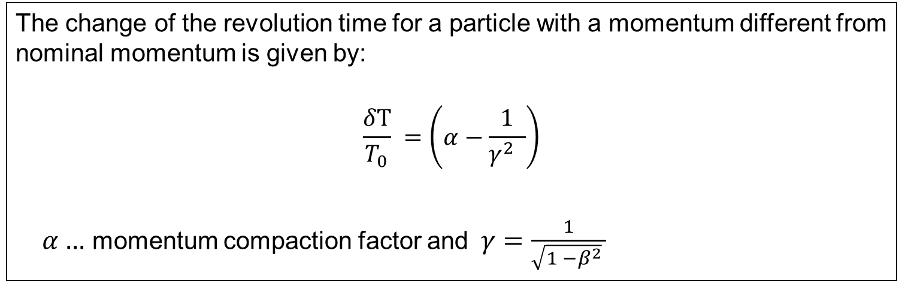
Momentum of a particle and orbit length
Particles with larger energy with respect to the nominal energy:
  …travel further outside => larger path length => take more time for a turn
  …the speed is higher => take less time for a turn
Both effects need to be considered in order to calculate the revolution time
The change of the revolution time for a particle with a momentum different from nominal momentum is given by:
$$\frac{δT}{T_{0}} =\left(α−\frac{1}{γ^{2} }\right)$$
  $α…$ momentum compaction factor and $γ=\frac{1}{\sqrt{1 −β^{2}} }$

Slide 24
Phase focusing in a circular accelerator
z
z
First turn
We assume three particles, the velocity is close to the speed of light
  A particle with nominal momentum
  A particle with more energy, and therefore higher velocity (blue)
  A particle with less energy, and therefore smaller velocity (green)
We assume that the three particles enter into the cavity at the same time
The red particle travels on the ideal orbit
The green particle has less energy, and travels on a shorter orbit
The blue particle has more energy, and travels on a longer orbit

Slide 25
Phase focusing in a circular accelerator– decreasing field
Cavity
z
Next turn
The particle with less energy (green) enters earlier into the cavity and is accelerated more than the red particle
The particle with larger energy (blue) enters later and is accelerated less. It loses energy in respect to the red particle

Slide 26
Phase shift as a function of the energy deviation

Slide 27
Acceleration in a cavity: particle with nominal energy
It is assumed that the magnetic field increases. To keep a particle with nominal energy on the nominal orbit the particle is accelerated, per turn by an energy of:
The energy is provided by the electrical field in the cavity:

Slide 28
Acceleration in a cavity: particle with a momentum different from the particle with nominal momentum
A particle with differing energy enters at a different time (phase) into the cavity, with an energy increase by:
The difference of energies is given by:
The change of energy for many turns (revolution T₀):

Slide 29
Acceleration in a cavity
If the difference with respect to the nominal phase is small:
and therefore:
differentiation yields:

Slide 30
Equation of motion
Change of phase due to the change of energy
Change of energy when travelling with a different phase through a cavity
We get:

Slide 31
Solution of the equation of motion
The equation describes an harmonic oscillator:
with the synchrotron frequency:
The energy difference between the nominal particle and particles with different momentum is:

Slide 32
Synchrotron frequency
Synchrotron frequency
For ultra relativistic particles γ >> 1 :
For particles with:

Slide 33
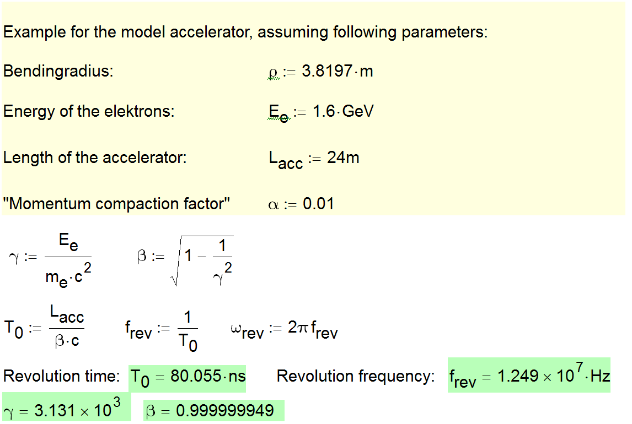
Example

Slide 34
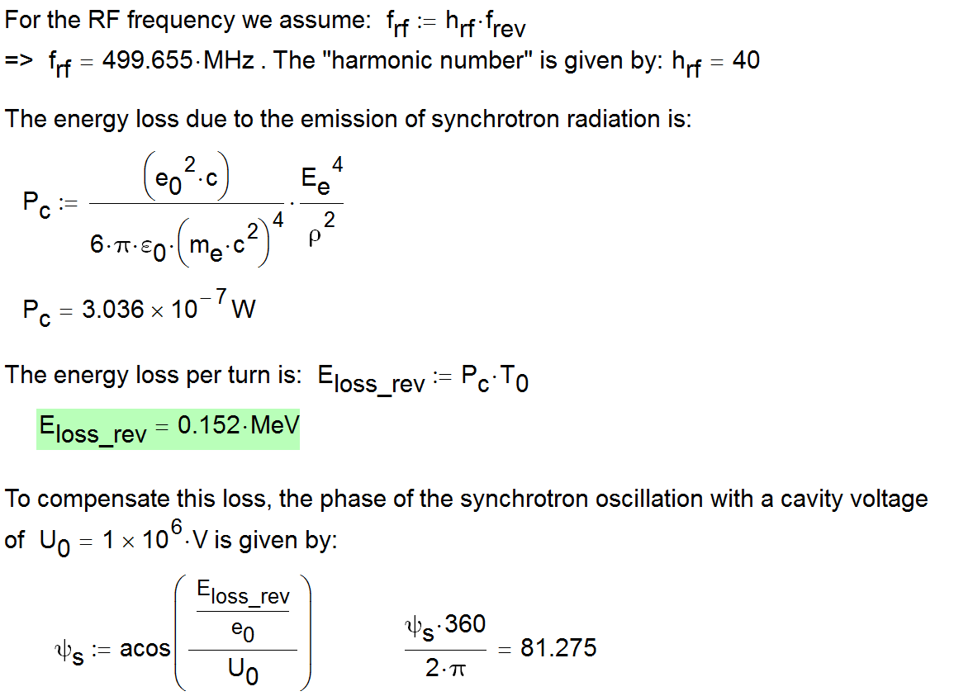

Slide 35
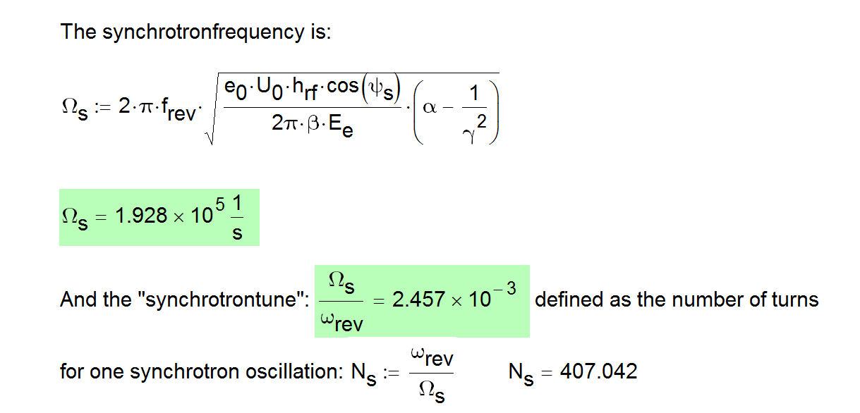
Synchrotron frequency of the model accelerator

Slide 36
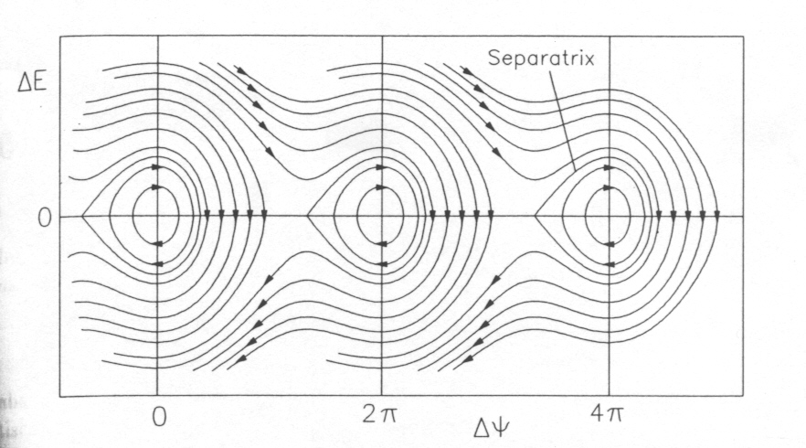
Phase space and Separatrix
Synchrotron oscillations are for particles with small energy deviation. If the energy deviation becomes too large, particle leave the bucket.
From K.Wille

Slide 37
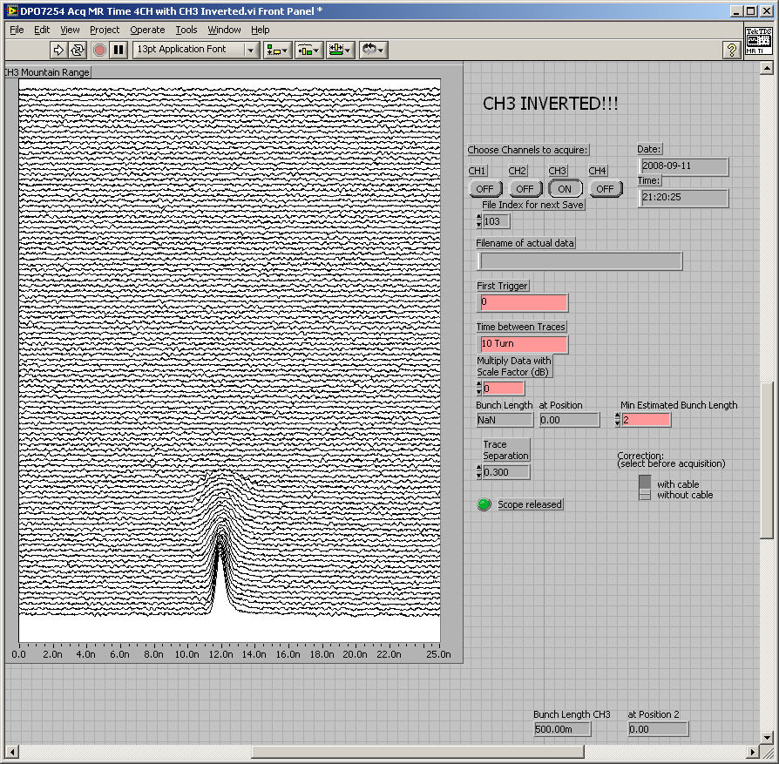
RF off, de-bunching in ~ 250 turns, roughly 25 ms
LHC 2008
about 1000 turns
single turn
Courtesy E. Ciapala

Slide 38
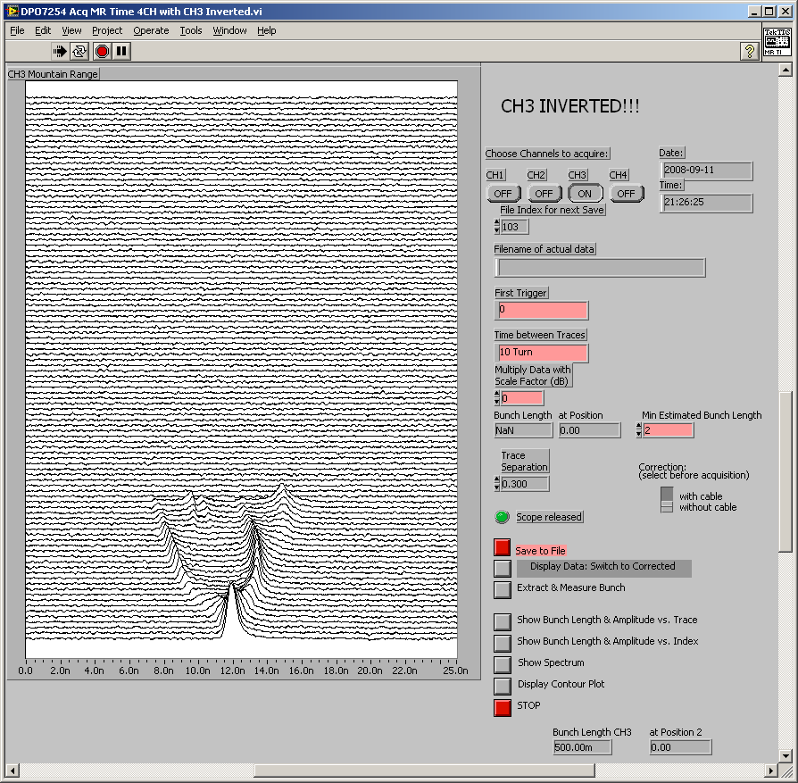
Attempt to capture, at exactly the wrong injection phase…
LHC 2008
Courtesy E. Ciapala

Slide 39
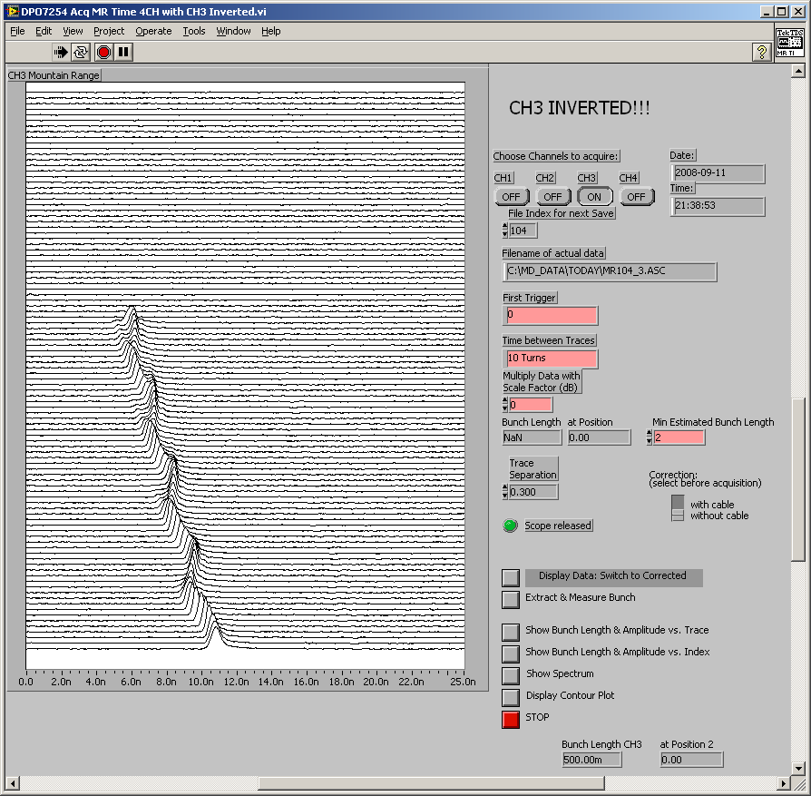
Capture with corrected injection phasing
LHC 2008
Courtesy E. Ciapala

Slide 40
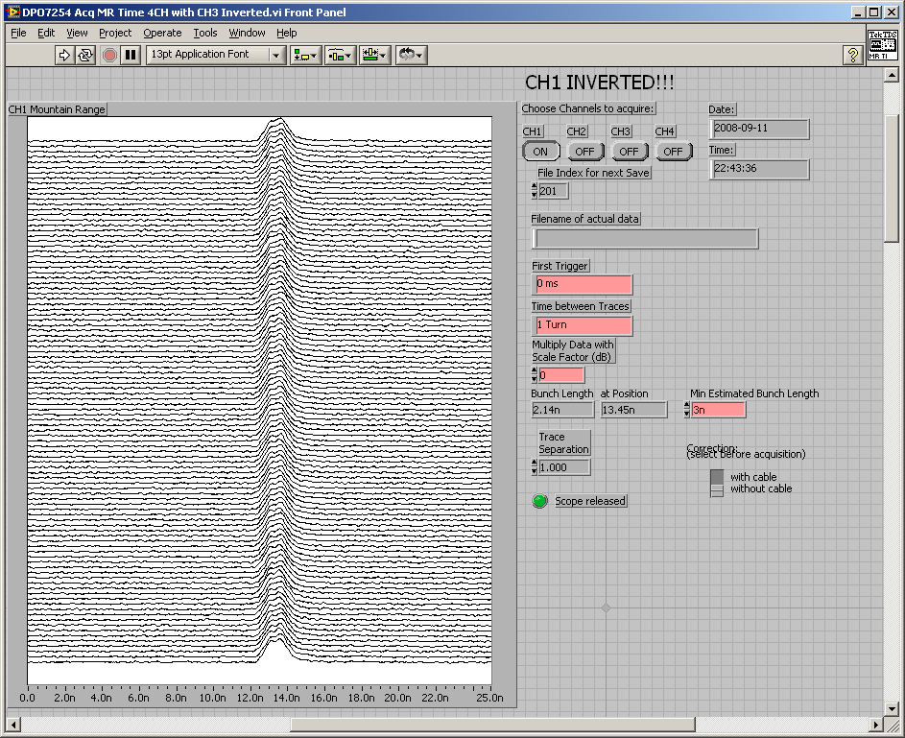
Capture with optimum injection phasing, correct frequency
LHC 2008
Courtesy E. Ciapala

Slide 41
RF buckets and bunches at LHC
The particles oscillate back and forth in time/energy
The particles are trapped in the RF voltage:
this gives the bunch structure
RF Voltage
2.5 ns
time
ΔE
LHC bunch spacing = 25 ns = 10 buckets ⇔ 7.5 m
RF bucket
time
2.5 ns
450 GeV 7 TeV
RMS bunch length 11.2 cm 7.6 cm
RMS energy spread 0.031% 0.011%

Slide 42
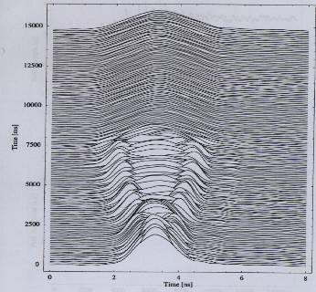
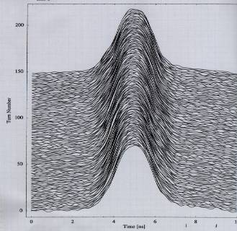
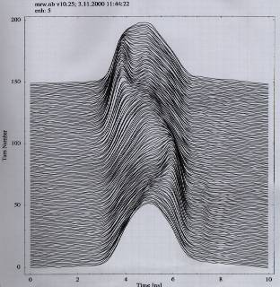
Longitudinal bunch profile in SPS
Instabilities at low energy
(26 GeV)
a) Single bunches
Quadrupole mode developing slowly along flat bottom. NB injection plateau ~11 s
Bunch profile during a coast at 26 GeV
stable beam
Bunch profile oscillations on the flat bottom –
at 26 GeV
Pictures provided by T.Linnecar

