Slide 1
Chapter 3
Development of Accelerators and of accelerator types
Rüdiger Schmidt (CERN) – Darmstadt TU - 2011 - Version E2.4

Slide 2
Outline
DC voltage Accelerator
RF - Accelerator
Linear accelerators
Cyclotrons
Synchrotrons
Storage ring

Slide 3
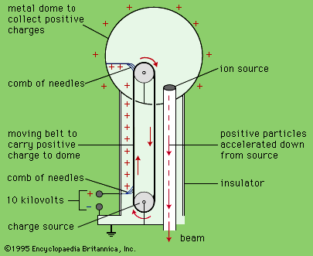
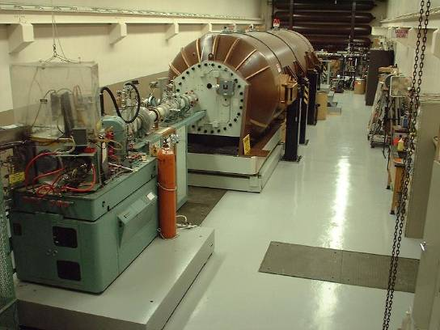
DC accelerators: Cockcroft–Walton and Van de Graaff Generator
In 1929/30 J.D.Cockcroft and E.T.S.Walton (Cavendish Labor, E.Rutherford) as well as R.J.Van de Graaff (Princeton) started to develop High Voltage Generators, for generating up to 10 MV.
The tandem Van de Graaff accelerator at Western Michigan University is used mainly for basic research, applications and undergraduate instruction.

Slide 4
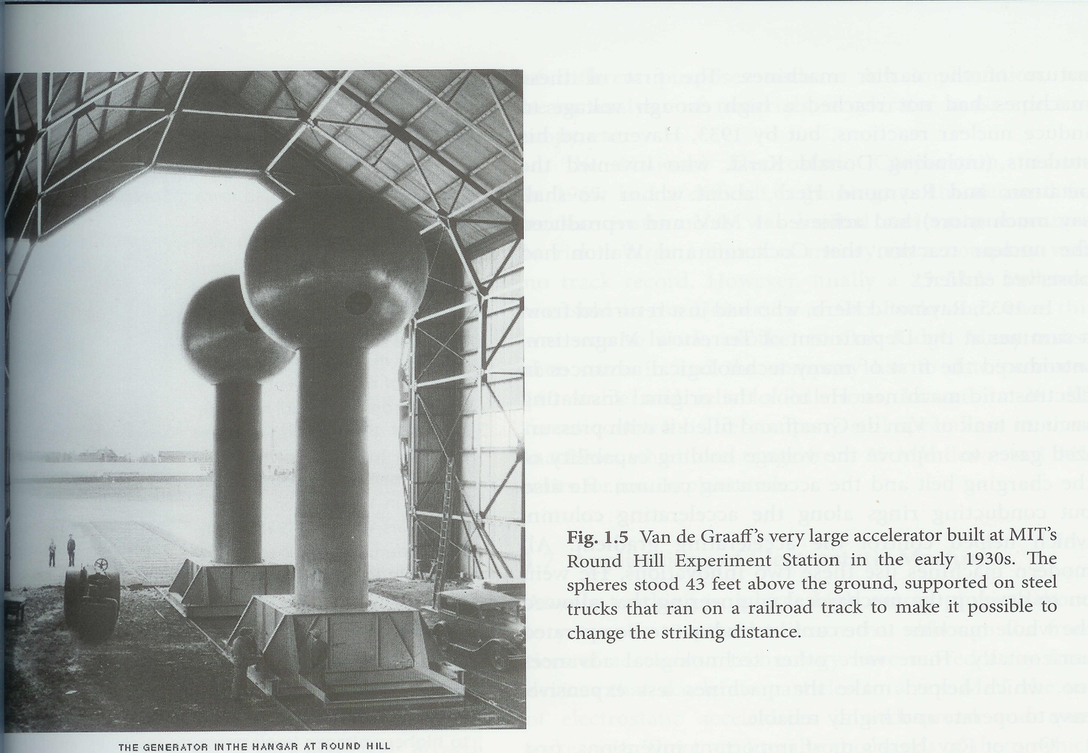
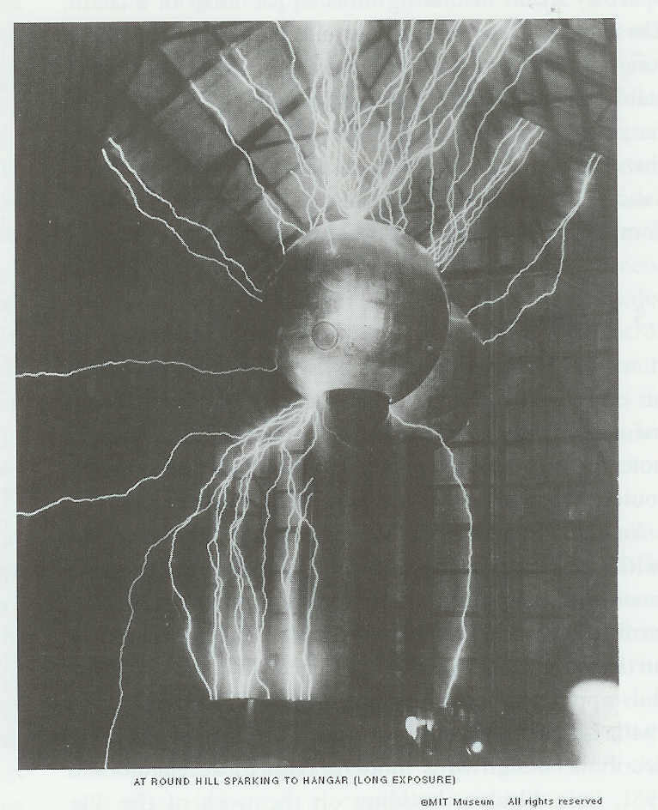

Slide 5
From DC to RF accelerators
The limit of high-voltage equipment is several million volts. The plants are very complex for higher energy, and higher voltage cause spark discharges.
Proposal of the Swedish scientist Ising 1924 to use fast-changing high-frequency voltage to accelerate instead of DC.
The Norwegian scientist Wideröe 1928 successfully tested the first linear accelerator, which is based on this principle.
Today almost all accelerators use RF systems for accelerating particles.

Slide 6
Acceleration with a high-frequency electric field
The voltage changes with time:
:=
⋅
(
⋅
π
⋅
)
U
(
t
)
U
0
sin
2
f
rf
t
Frequecy :
f
rf
=
100
MHz
Maximum voltage:
U
=
1
×
10
6
V
0
.
6
U(t)
1
10
5
.
10
5
Voltage
0
5
.
10
5
1
.
10
6
1
.
10
8
5
.
10
9
0
5
.
10
9
1
.
10
8
Time

Slide 7
Linear accelerator (LINAC)
l₁
l₂
l₃
l₄
l₅
l₆
l₇
Source of particles
RF generator with fixed frequency
Metallic drift tubes
~
Particles exit from the source and are accelerated by the potential of the first drift tube
While the particles travel through the drift tube, the sign of the potential reverses
The particles exit from the first drift tube and are accelerated by the potential of the second drift tube
As the speed of the particles increases, the distance between two tubes increases

Slide 8
l_{i}
Energy of a particle after the first tube:
U₀ is the maximum voltage of the RF generator and Ψ_{s} the average phase of the particle between the two tubes
+
+
Consequence: it not a possible to accelerate continuous beam, the particles are accelerated in bunches, the average bunch length is between less than 1 mm up to 1 m

Slide 9
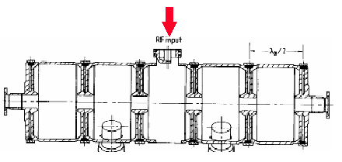
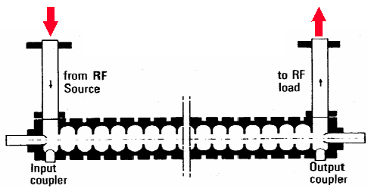
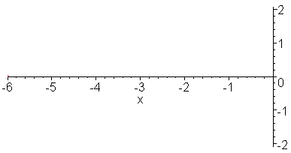
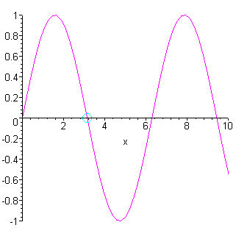
Radio frequency cavity
Standing wave
Travelling wave

Slide 10
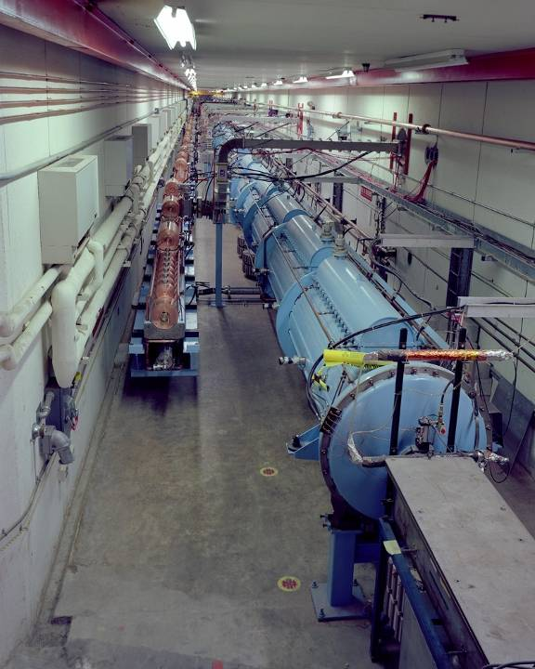
Linear Accelerator at FERMILAB
1971, upgraded in 1993
Linac can accelerate beam to 400 MeV
Low energy end of the Fermilab linac is an Alvarez style drift tube linac.
The accelerating structures are the big blue tanks shown in the photo.
The five tanks of the low energy end take the beam from 750 KeV to 116 MeV.
The resonant frequency of the cavities is 200 MHz.

Slide 11
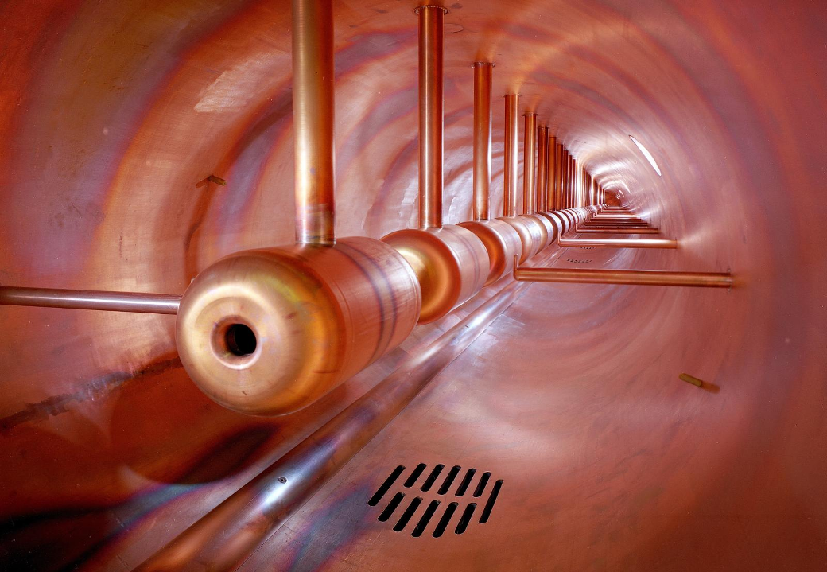
Linear accelerator structure at FERMILAB

Slide 12
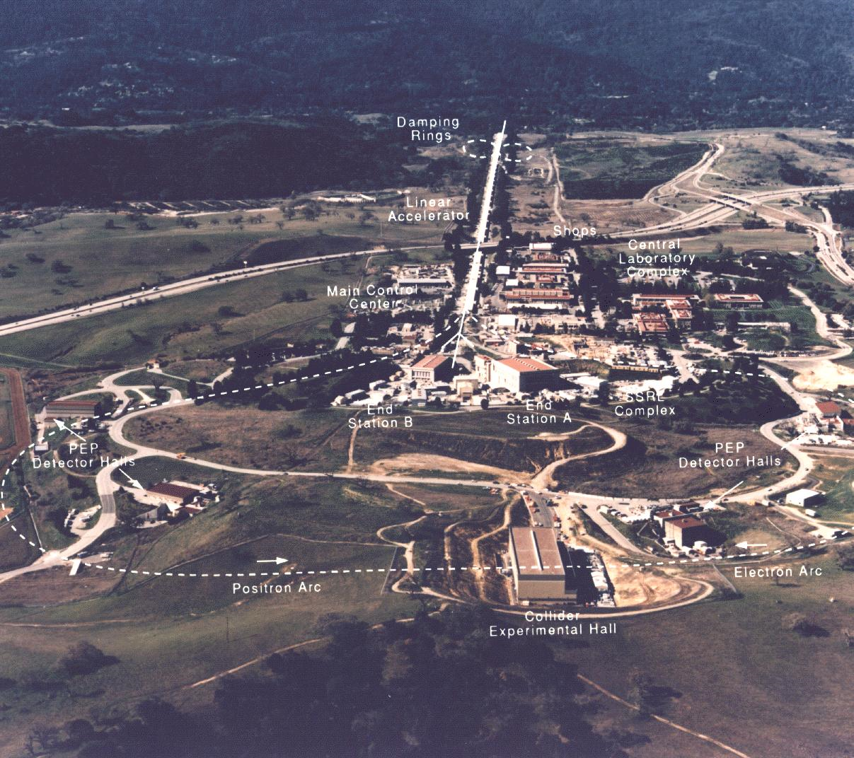
Linear Accelerator: Acceleration in a single pass travelling through many RF cavities
SLAC (Stanford Linear Accelerator), with a length of 2 miles– Palo Alto close to San Francisco, since about 1970
Most of the components are RF cavities

Slide 13
Circular accelerator: cyclotron
For a particle that moves perpendicular to the magnetic field:
This results in a circular motion of the particle:
Equilibrium between Lorentz force and centrifugal force
z
s
B
v
F
x
The cyclotron frequency ω is independent of speed and energy of the particle.
When increasing energy and speed the particle travels with a larger radius in the magnetic field.

Slide 14
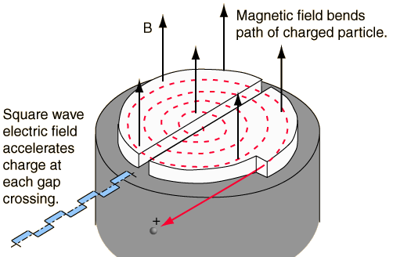
Circular accelerator: cyclotron
The time for a turn is constant, therefore the frequency of the electric field for the acceleration is constant.

Slide 15
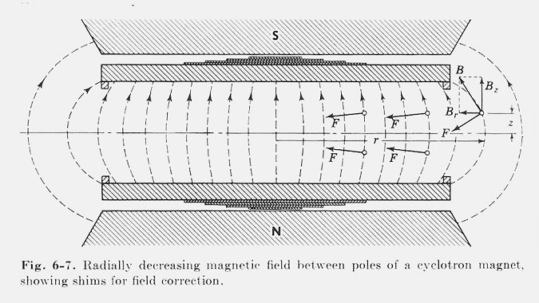
Vertical focusing in the cyclotron
People just got on with the job of building them.
Then one day someone was experimenting
The Figure shows the principle of vertical focusing in a cyclotron
In fact the shims did not do what they had been expected to do
Nevertheless the cyclotron began to accelerate much higher currents
E.Wilson Lectures 2001

Slide 16
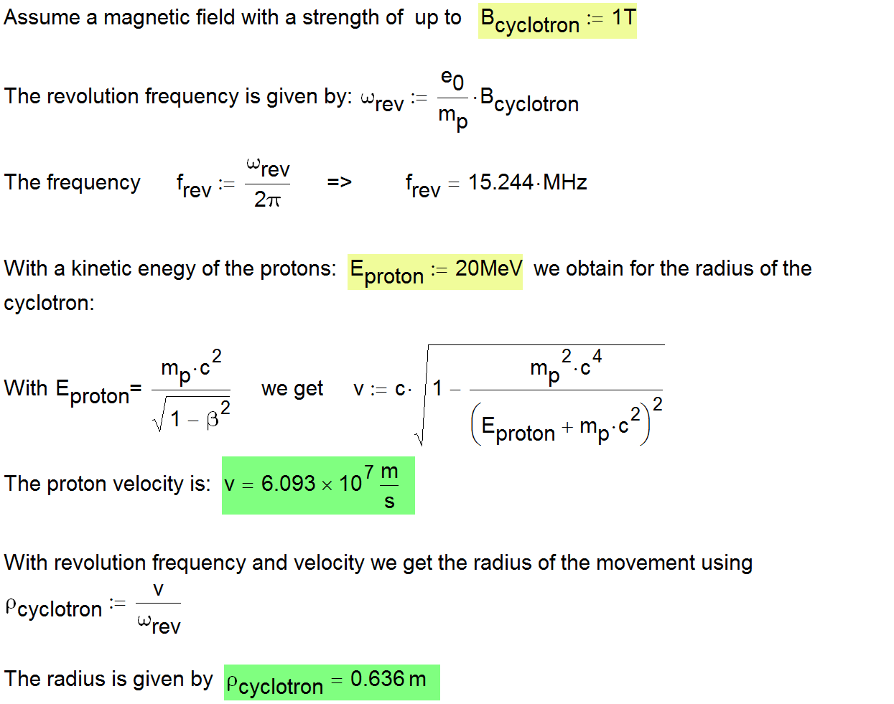
Example for the parameters of a proton cyclotron

Slide 17
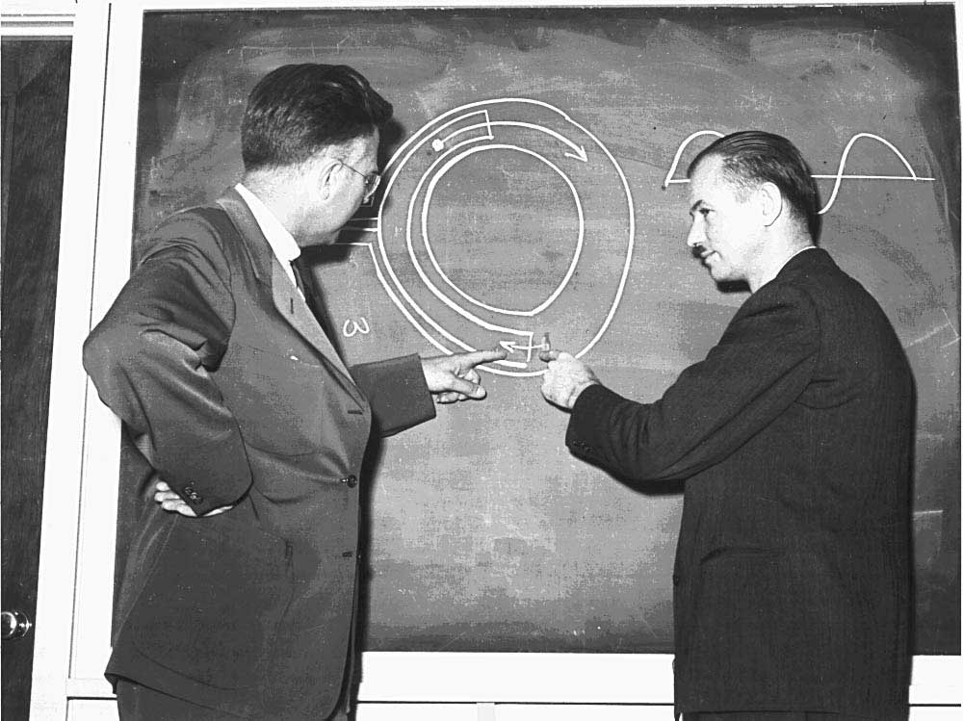
E.O Lawrence – inventor of the cyclotron
The inventor of the cyclotron, E. O. Lawrence, and his student E. McMillan, one of the two inventors of the principle of phase stability show the accelerating point at the entrance to a screened semi-circular electrode structure.
www4.tsl.uu.se/~kullander/Nobel/index.html

Slide 18
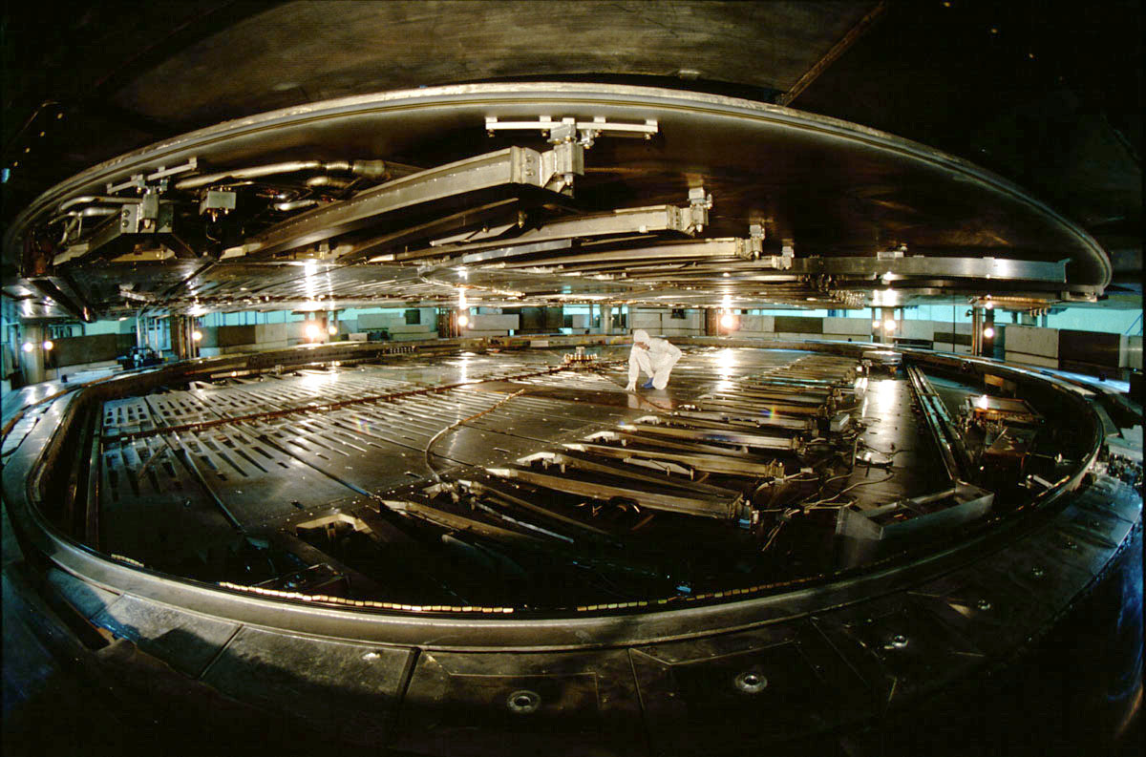
Cyclotron atTRIUMF, Canada's national laboratory for nuclear and particle physics, houses the world's largest cyclotron: 18m diameter, 4000 t main magnet, B=0.46 T while a 23 MHz 94 kV electric field is used to accelerate the 300 μA beam

Slide 19
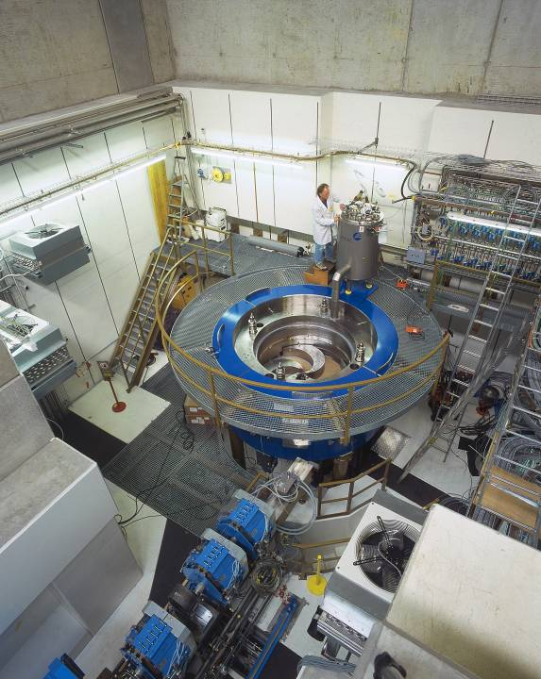
Cyclotron at PSI
Medical Cyclotron at PSI, designed for a later application of proton therapy in hospitals weights 90 tons and has a diameter of 3.2 m
Protons with 60 percent of the speed of light
Superconducting coils
Physicists and engineers from Michigan State University, of the PSI and ACCEL instruments GmbH
A second such cyclotron is for the first clinical Proton Therapy Center in Europe, which will be built in Munich, currently in production at Accel
http://images.google.de/imgres?imgurl=http://www.ethlife.ethz.ch/images/psi_zyklotron-l.jpg&imgrefurl=http://www.ethlife.ethz.ch/articles/news/psi_zyklotron.html&h=1004&w=800&sz=405&tbnid=mw0NqgE2g2cX9M:&tbnh=149&tbnw=118&hl=de&start=2&prev=/images%3Fq%3Dzyklotron%2Bpsi%26svnum%3D10%26hl%3Dde%26lr%3D%26sa%3DG
http://erice2009.na.infn.it/TalkContributions/Schirrmeister.pdf

Slide 20
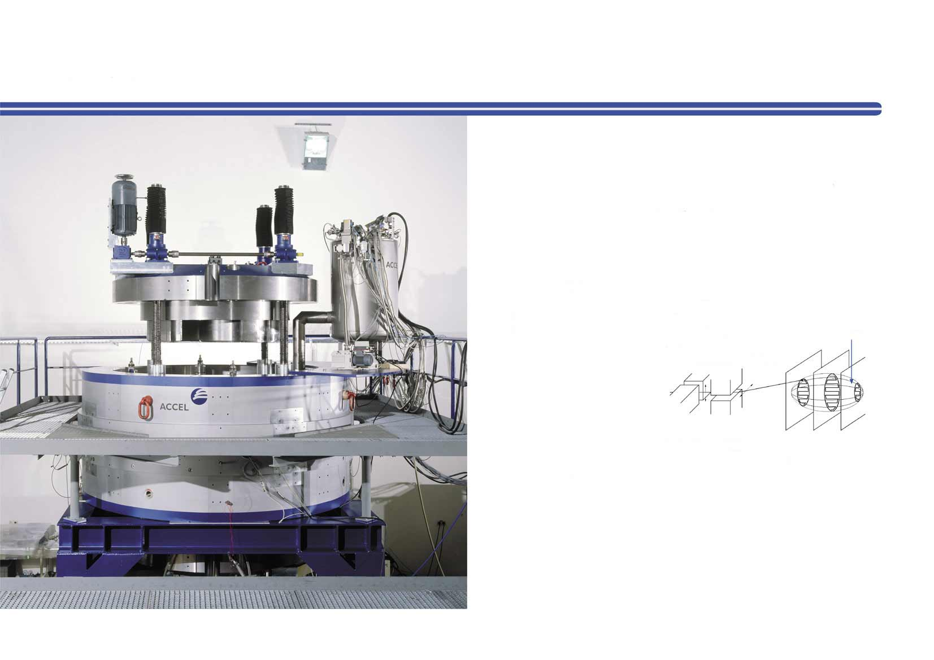
Superconducting Cyclotron and Fast Proton Beam Scanning for Hadron Therapy
Advantages of a Cyclotron
• Max. energy 250 MeV with fast energy variation by energy selection system
• High availability / up-time
• Reasonable investment / operating cost
• Fast and simple maintenance procedures, small operator group
• Low activation
Advantages using superconducting Magnet Coils
Make use of achievable high fields in larger volume to increase
Gap size over full radius -> avoid non- linearities -> improved extraction
Efficiency to larger than 80%
No ohmic losses of Cu-coils -> less rated power needed and reduced electrical consumption
Closed cycle Liquid He operation -> easy maintenance
„Warm“ access as in a normal conducting cyclotron
http://www.protonen-therapie.de/pg_0006.htm

Slide 21
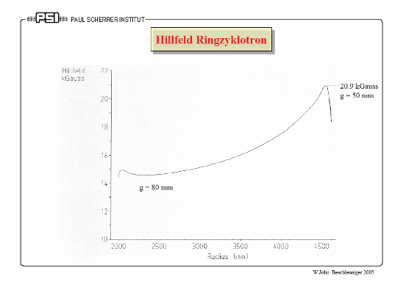
Isochroncyclotron
When increasing the speed of the particle, the magnetic field must also grow with the radius:
http://abe.web.psi.ch/accelerators/vortraegeWernerJoho/

Slide 22
Circular accelerators: Synchrotron
With a Cyclotron or Betatron the energy of the particles is limited
It is not possible to build any arbitrarily large magnets
The magnetic field is limited to some Tesla (normal-conducting 1-2 Tesla, superconducting 5-10 T)
To accelerate to high energy, the synchrotron was developed
Synchrotrons are the most widespread type of accelerators
The synchrotron is a circular accelerator, the particles make many turns
The magnetic field is increased, and at the same time the particles are accelerated
The particle trajectory is (roughly) constant

Slide 23
Development of Synchrotrons
Proposed 1943 by M.O.Oliphant
Ideas at about the same time 1945 by E.M. McMillan (University of California) and V. Veksler in the Soviet Union
First working Synchrotron (proof of principle) in England (Birmingham) by F.Goward and D.Barnes
Energy gain through electric field, the magnetic field is increased to synchronously
Magnetic field
Beam intensity
450 GeV
Extraction
Example: CERN-SPS
Protonsynchrotron
14 GeV
Injection
Injection
Extraction
Time
14 sec
cycle

Slide 24
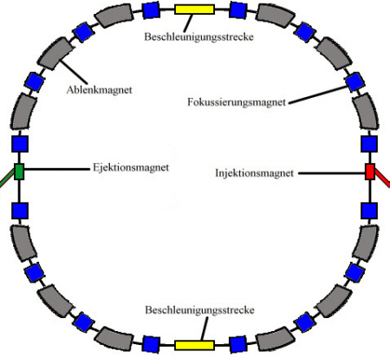
Components of a Synchrotron
Components of a synchrotron:
deflection magnets
magnets to the focus beams
injection magnets (pulsed)
extraction magnets (pulsed)
acceleration section
vacuum system
diagnosis
control system
power converter
RF cavities
Deflecting magnets
Focusing magnets
Extractionsmagnets
Injectionsmagnets
RF cavities
Circular Accelerator: acceleration in many turns with (a few) RF cavities

Slide 25
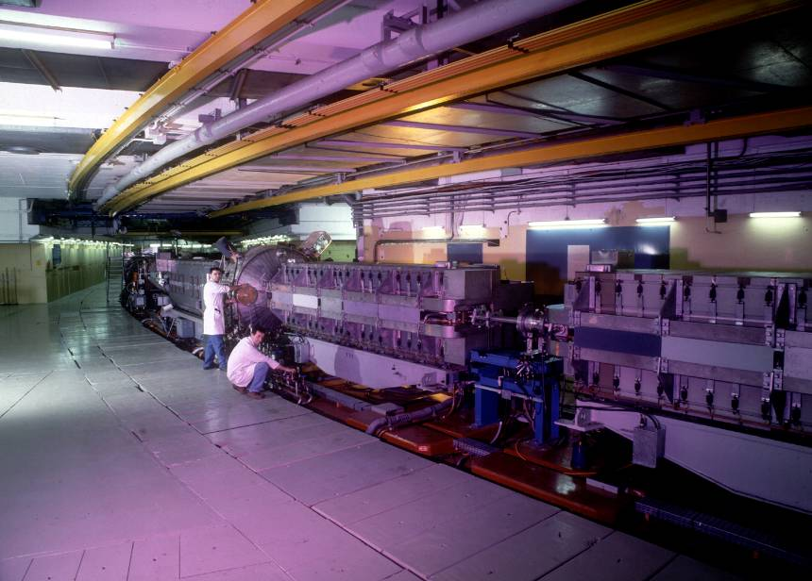
CERN Protonsynchrotron (CERN-PS)
since1959, still a central machine at CERN, e.g. as LHC injector

Slide 26
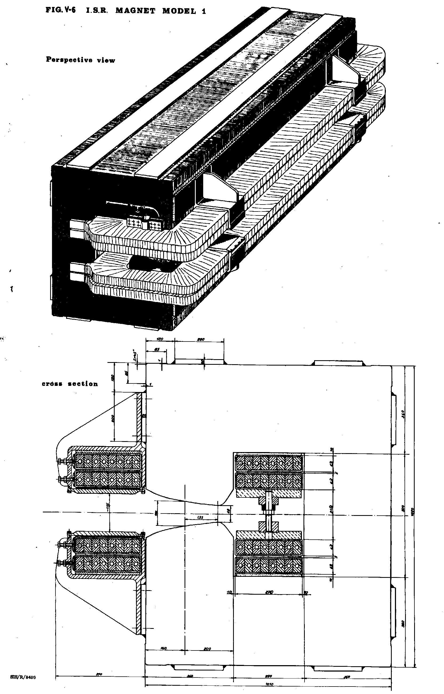
Typical Synchrotron Magnet

Slide 27
Acceleration in a Proton Synchrotron – CERN SPS I

Slide 28
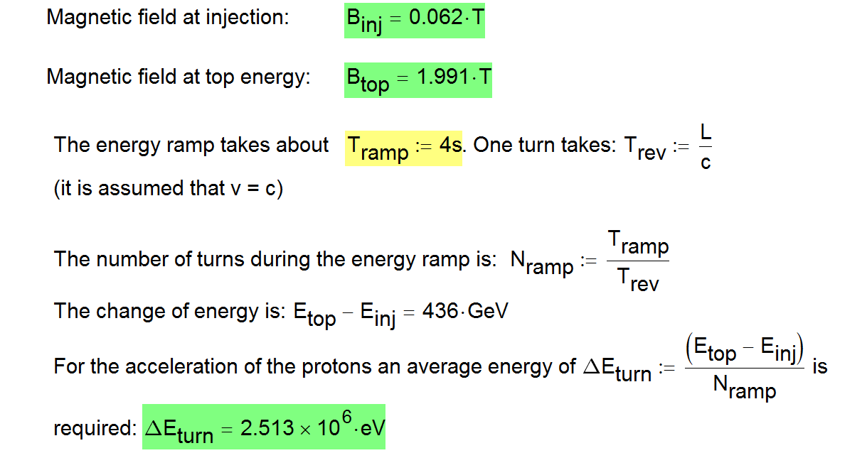
Acceleration in a Proton Synchrotron – CERN SPS II

Slide 29
Circular accelerator: Storage ring
Storage rings are a special case of a synchrotron
The particles are accelerated and stored for a long time (hours or even days)
Main applications of storage rings is the production of synchrotron radiation and the generation of new particles
LEP was the accelerator with the largest circumference with a length of 27 km. LEP was shut down after 12 years operating time end of 2000.
In the LEP tunnel the LHC was installed as superconducting proton accelerator.
LEP: Centre of mass energy = 210 GeV
LHC: Centre of mass energy = 14000 GeV
Elektrons
Positrons
Protons
Protons

Slide 30
To reach high energies ...example LEP
Acceleration structures (radio-frequency of cavities) are needed in most accelerators
Normal-conducting cavities of copper: 1-2 MV/m can be routinely achieved.
With pulsed cavities (e.g. SLAC) accelerating gradient is much higher - between 50-80 MV / m (in development)
With supraconducting cavities:
  LEP (CERN – 2001): 5-8 MV/m
  ILC : about 35 MV/m
The final energy of e+ and e-beams of the LEP Collider was about 100 GeV. If the accelerator would have been built as LINAC (25 years ago), it would have had a length of:
L = 100 GeV / 2.5 MeV/m = 40000 m
for each of the two accelerators for electrons and positrons - i.e. 80 km. Furthermore the superconducting cavities would have been more expensive.
Centre-off-mass energy = 200 GeV
Elektronenlinac 40 km
Positronenlinac 40 km

Slide 31
LEP
The particles are accelerated during every turn by the acceleration structure
One turn takes 89 µs
In one second, a particle makes 11246 turns and travels during every turn through the acceleration section
At injection energy of 20 GeV the magnetic field in all deflection magnets is about 0.024 Tesla
During acceleration from 20 GeV to 100 GeV, the magnets are ramped to 0.119 Tesla
The ramp takes a few minutes
LEP – length 26.8 km
About 4 bunches / beam
One vacuum chamber

Slide 32
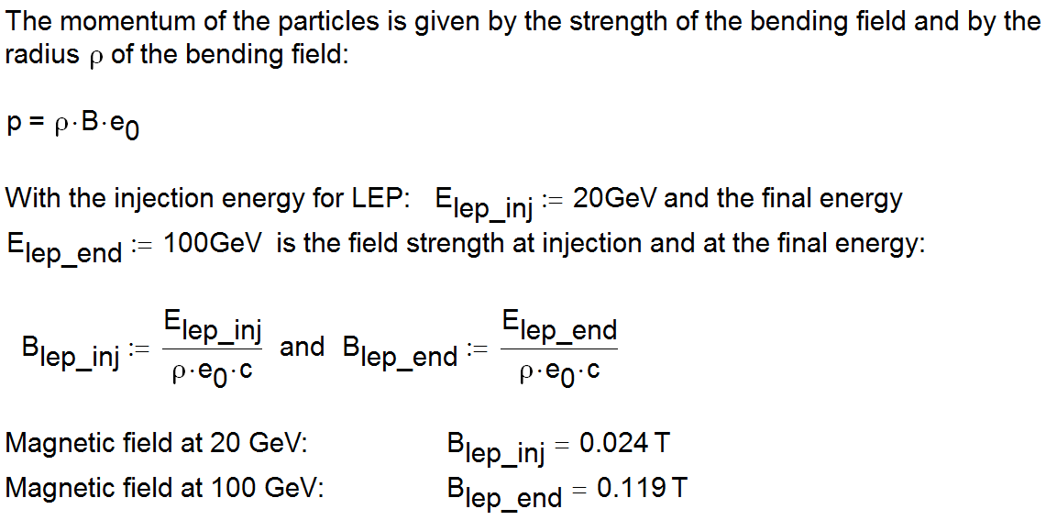
Energy ramp at LEP

Slide 33
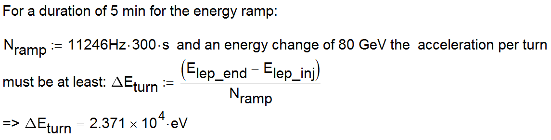
Acceleration in a circular accelerator
From this assessment, a voltage of some 10 kV would be enough to accelerate a particle of 20 GeV to 100 GeV.
In the LEP, the acceleration structures however have a voltage of about 2-3 GV (!)
=> Emission of synchrotron radiation

Slide 34
Consequences of the emission of synchrotron radiation
Storage rings are built for electrons and positrons to produce synchrotron radiation
In the LEP tunnel e+ e- cannot be accelerated to an energy much above 100 GeV, the energy loss is too large
To accelerate to higher energy…
In the LEP tunnel the LHC has been installed, as protons can be accelerated to much higher energy (LHC = 7 TeV)
e + e can be accelerated to higher energy with linear accelerators

Slide 35
LHC Parameter
The force on a charged particle is proportional to the charge, and to the vector product of velocity and magnetic field:
z
s
B
v
F
  Maximum momentum 7000 GeV/c
  Radius 2805 m
  Bending field d B = 8.33 Tesla
  Magnetic field with iron magnets can provide up to 2 Tesla, therefore superconducting magnets are needed
x

Slide 36
ANHANG

Slide 37
Beschleunigung durch ein zeitlich veränderliches Magnetfeld: Betatron
Vakuumkammer
Ein zeitlich veränderliches Magnetfeld
induziert im Vakuum ein elektrisches Feld
Eisenjoch
Spulenwindung
nur im Script

Slide 38
Induktionsgesetz
Ein zeitlich veränderliches Magnetfeld
induziert in einem Leiter einen elektrischen Strom
nur im Script

Slide 39
Betatron
Das erste Betatron wurde von D.W.Kerst 1940 an der Universität Illinois gebaut. Elektronen wurden bis 2.3 MeV beschleunigt.
Wenig später wurde ein Betatron mit einer Energie von bis zu 20 MeV realisiert.
Heute werden Betatrons insbesonders für medizinische Anwendungen benutzt.
Das Spulenfeld wird mit einem Wechselstrom erzeugt
nur im Script

Slide 40
Parameter eines Betatron
nur im Script

